Slide 1
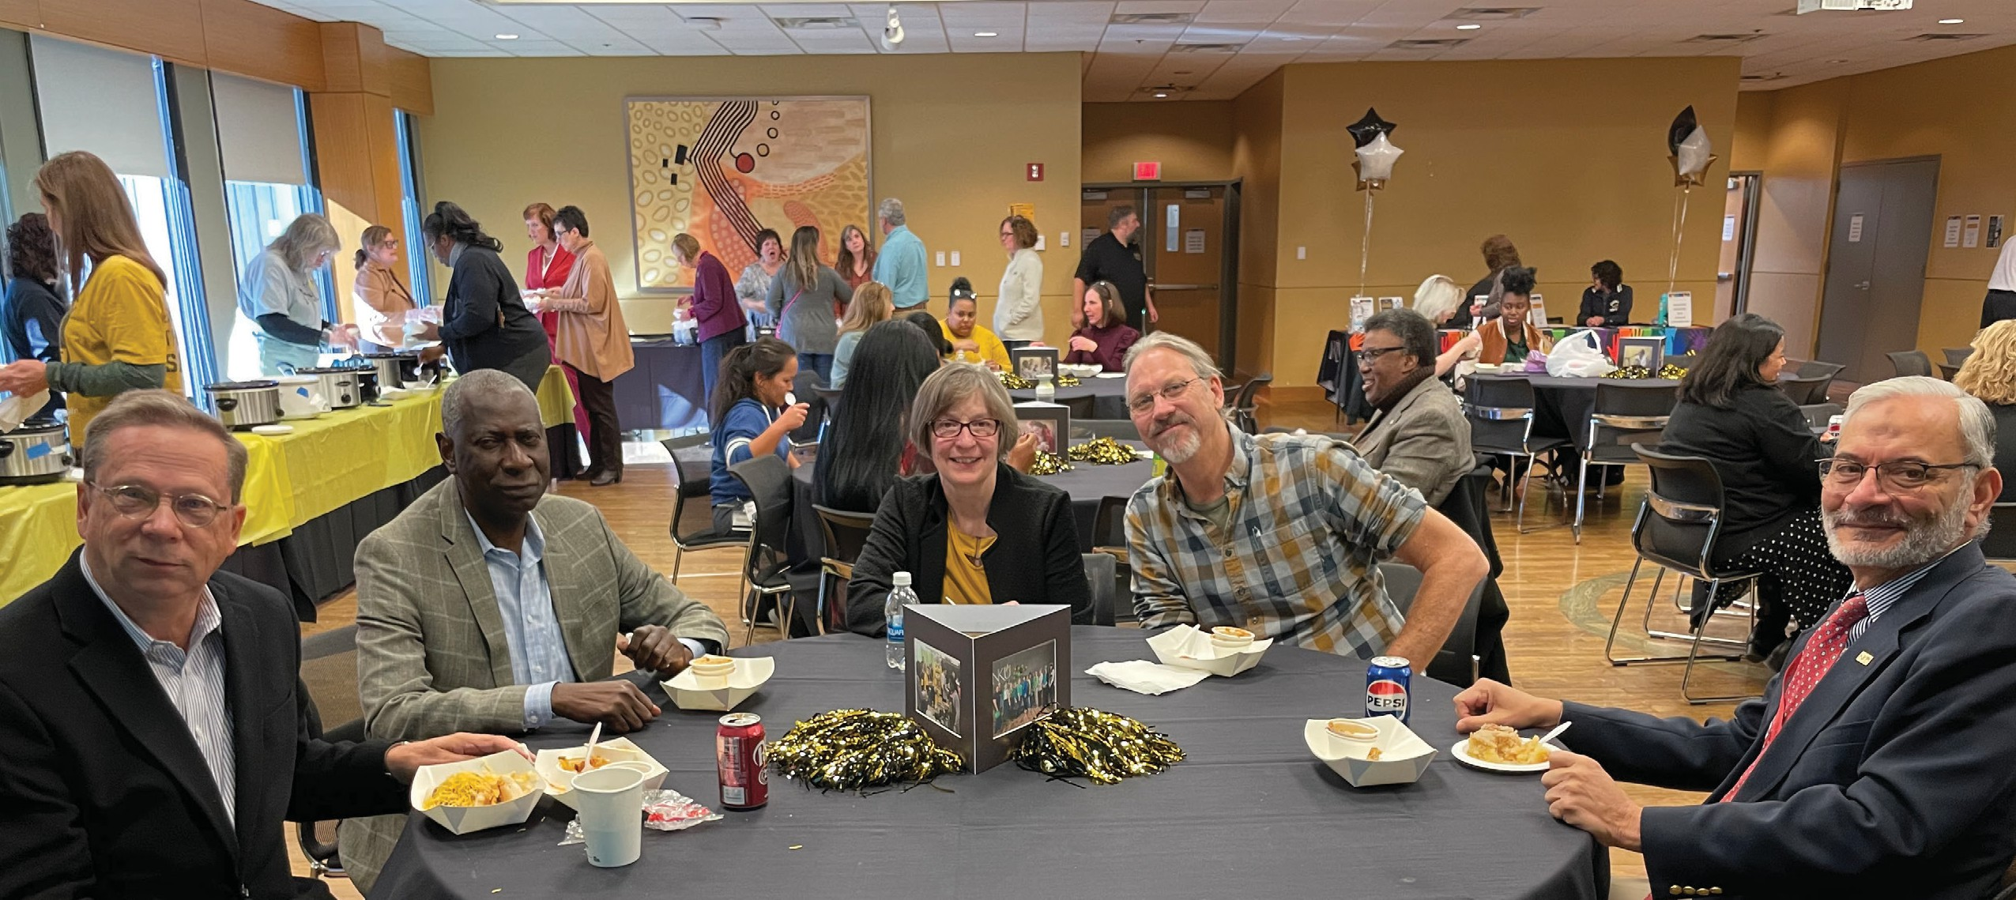
43RD
ANNUAL
STAFF APPRECIATION

Slide 2
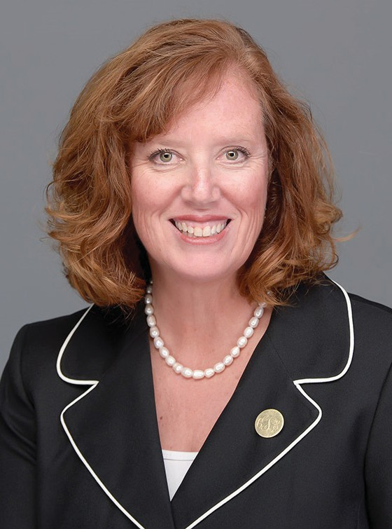
At Northern Kentucky University, we create a welcoming campus where learners find plenty of opportunities to make their dreams a reality. Every day, we transform lives and we work tirelessly to ensure learners graduate and become the future leaders of this region and the world.
Our staff embody the true power of NKU with passion for student success and student readiness. You support our faculty and learners along the path to graduation, removing barriers and championing their successes in the world. In fact, we could not do the important work we do here without you. Today is a celebration of togetherness and recognition of your hard work and commitment to our mission.
I am also excited to join you in celebrating our 2024 Regents Distinguished Service Award recipients, those employees who have made exceptional contributions to our student-ready mission. These wonderful people have impacted many lives, and it is truly a delight to honor them today.
Working in higher education has its challenges, but we love what we do — and we believe in it.
In my time as your president, I have witnessed this devotion and I appreciate the impact and the leadership you show each day. It is my pleasure to recognize each of you who make this university the great place that it is. Thank you for your exceptional work and all you do for our learners, our university and the region.
Cady Short-Thompson, Ph.D.
President, Northern Kentucky University

Slide 3
30 YEARS OF SERVICE
Amanda Steinbrunner
College of Health & Human Services
Joseph Wendeln
IT - Infrastructure & Operations Group
Jill Wood
Campus Recreation
Paul Hundemer
Building Trades
Tammy Knochelmann
President’s Office
Cindy Knox
Accessibility Services
Jackie Marsala
Nursing Undergraduate Studies
Kyle Martin
IT-SLCM Business Support Group
Lisa McElfresh
Career Services
Thomas Nusekabel
Housing Facilities Management
Timothy Pickens
Electric Shop
Thomas Ramstetter
Marketing & Communications
Michelle Rittinger
Building Services 2nd Shift
Steve Scott
Plumbing & Sheet Metal
Charles Tabor
HVAC/General Maintenance
Christopher Tambling
Student Union & Services
Joseph Green
Advancement Services
The individuals listed on the following pages are recognized for celebrating continuous, uninterrupted years of service during calendar year 2023.
25 YEARS OF SERVICE
Judy Carr
Building Services 1st Shift
Jill Diesman
IT - Infrastructure & Operations Group
Michael Frazier
Marketing & Communications
Kenneth Goins
Building Services 1st Shift
Lori Smith
Educational Leadership & Adv.Studies
Nathan Webster
Power Plant
15 YEARS OF SERVICE
Rebecca Bishop
Comptroller - General Accounting
Tiffany Budd Sustainability & Utilities Dorian Chapman Building Services 1st Shift Amy Danzo
Testing Services
Brigitte Evans
IT - Information Technology Central
Jeffrey Foster
University Police
Christopher Hafling
Athletics Facilities
Janet Harrah
Center for Economic Analysis & Development
Melanie Hartzel
Community Connections
IN MEMORIAM
Patrick Harting
HVAC/General Maintenance
Courtney McManus
Art & Design
20 YEARS OF SERVICE
Betty Castle
Procurement Services
Sandra Fromeyer
Administration & Finance
Carole Gibson
Bus. Operations & Auxiliary Services
Steven Jones
IT - Infrastructure and Operations Group

Slide 4
Jeremy Wilson
Office of Account Services
Krista Wiseman-Moore
Special Events
Stephanie Huber
HR - Benefits Management
Jeanie Kirby
Building Services 1st Shift
Gregory (Alex) Koeninger IT-Enterprise Systems Group Bruce Kohsin
Parking Services
Rosal Kreyling
Building Services 2nd Shift
Joni Landwehr
Mathematics and Statistics
Stephanie Menchen
Testing Services
Johnathan Murray
University Police - Field Operations
Amy Pieper
First Year Student Success Hub
Timothy Rieskamp
IT - Information Technology Central
Dale Schwarber
HVAC/General Maintenance
Dionna Sholler
Human Resources
Amy Sterrett
MS Cardio Perfusion
Teresa Walker
O&M Administrative Services
Marilisa (Lisa) Wolf
Accounts Payable
Thomas Hervey
IT - Infrastructure & Operations Group
Mary Howell
Building Services 1st Shift
Denise Martin
Building Services 1st Shift
Hunter Miggelbrink
IT - Infrastructure & Operations Group
Guy Neace
Building Services 1st Shift
Carolyn Noe
Institute for Health Innovations
Warren O’Connell
Housing Facilities Management
Michael Paynter Building Services LaNighta Reid
Student Financial Assistance
Kelli Rieskamp
Ctr. Integrative Nat Science & Math
Jeannie Ritter
Parents Attending College
Christina Ryle
Planning & Institutional Research
Leslie Schultz
Alumni Engagement & Annual Giving
10 YEARS OF SERVICE
Lora Anneken
IT-Enterprise Systems Group
Joan Brummer
Music
Rhett Clark
IT - Infrastructure & Operations Group
Duane Cottle
IT - Infrastructure & Operations Group
Randall Cutler
Counseling Services
Beris Dizdar
Biological Sciences
Thomas Fix
Ctr. Excellence in Teaching & Innovation
Eric Gentry
University Advancement
Blaine Gilmore Procurement Services Melanie Hall
School of Social Work
5 YEARS OF SERVICE
Rachel Atchley
Kentucky Center for Mathematics
David Bond University Registrar Beverly Breeze
Academic and Student Affairs
Sharon Criss
Athletics Internal Operations
Caitlin Drouillard University Connect & Persist Nanette Freadreacea
College of Health & Human Services
Holly Funk
Chemistry & Biochemistry
Damian Geiger
IT - Infrastructure & Operations Group
Christopher Hahn HVAC/General Maintenance Valerie Hardcastle
Institute for Health Innovations

Slide 5
5 YEARS OF SERVICE
Javance Sinclair
Community Standards Care
Scott Williams
IT - Information Technology Central
Kenneth Wolterman
Budget, Financial Planning & Analysis
Christine Yankovsky
All Card Administration

Slide 6
1990
Dolores Thelen Jack Menninger Shirley Raleigh 1991
Barbara Herald Jeannine Holtz 1992
A. Dale Adams Donna Redmond William Schack 1993
Rebecca Myers Janis Reynolds 1994
Connie Hurst Roger Black Dan Spence
Vanessa Johnson
1995
Donald Grothaus Leva Kidd Kathleen Stewart 1996
Edith Hill Jacquelyn Baker John Stevens 1997
Jane Schwierjohann Charlene Schweitzer Janet Neltner
1998
Joyce Moore Beth Sweeney Margie Black 1999
Michael Nutini Diana Schneider Betty Mulkey 2000
Debbie Billiter William Davis Royleen Seibert 2001
Mimi Assanuvat Ferial Ware Thelma Gross 2002
Jeff Baker Judith Strange Terry Linkugel 2003
Janice Rachford James Benson Lenore Chambers 2004
Diane Hunley Kevin Rossell Randy Kelley 2005
Sue Meagher Angela Schaffer Jonathon Mason
2006
Melissa Gorbandt Angela Gabbard Anthony Raniero, Sr. Gina Bray
2007
Brenda (Kay) Reedy Jeanne Papania Steve Povkov 2008
Melinda Berry Paul Melville 2009
Doug Wells Diane Temming Mark Owen 2010
Charles L. Pettit Lisa Schultz Kathleen McBryan 2011
Connie Lawrence Michelle Jones Carole Ziegler 2013
Vivian Colemire Kimberly Vance Robert Fox 2014
Tina Altenhoffen Jackie Marsala Millie McLemore
2015
Charles Bowen Elizabeth McCubbin Frank Wilfong 2016
Barbara Barnes Katie Lovold Ophelia Marks 2017
Mark Niekirk Cheryl Volpenhein Erin Smith
2018
Constance Kiskaden Sheila Rubin
Pam Wagar
2019
Kimberly Wiley Amanda Meeker Ann Harding 2020
Michele Kay David MacKnight Lisa McElfresh 2021/2022
Chris Tambling Krista Rayford
Kari Wright Perkins
2023
Tiffany Budd Mary Paula Schuh
Jennifer Richmond
PAST AWARD RECIPIENTS
The Northern Kentucky University Regents Distinguished Service Award is bestowed upon staff employees who have made exemplary contributions
to the growth, image or efficient operations of the university. Nominations for the award are reviewed by a panel of staff members and are judged on the basis of criteria in which individuals demonstrate such exemplary contributions. This award has been funded since 1990 by the generous contributions of the Northern Kentucky University Foundation, Inc.

Slide 7
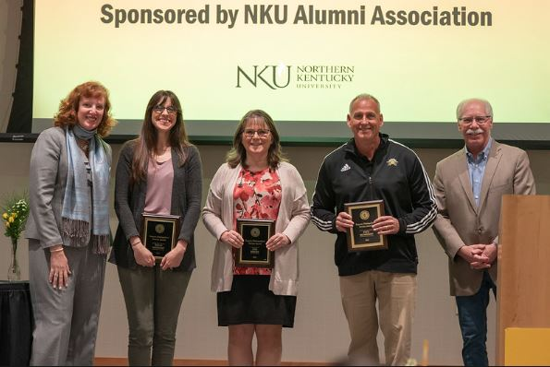
2024 Regents Distinguished Service Recipients: Kellie Rieskamp-CINSAM, Lisa Moore-Chase Career Services, Paul Hundemer-Building Trades. Presenters: Regent Richard Boehne and President Cady Short-Thompson.

Slide 8
BOARD OF REGENTS
Richard A. Boehne, Chair Nathan Smith, Vice Chair Kara Williams, Secretary
Cori Henderson Ashley F. Himes Ken Perry Isaiah Phillips Sandra Spataro Andrá R. Ward Brad Zapp

