Slide 1

33rd Annual
John O’Bryan
Mathematics Contest
Two-Person Speed Competition

Slide 2
Basic Rules
Eight Questions; Three Minutes Each
NO CALCULATORS on the First Four Questions!
One Answer Submission Allowed Per Question; To Submit, Fold Answer Sheet and Hold Above Your Head for the Proctor; Answer must be submitted within 5 seconds of timer in order to count.
Scoring (Each Problem)
  First Correct Answer = 7 points
  Second Correct Answer = 5 points
  All Other Correct Answers = 3 points

Slide 3

The Next Slide Begins The Competition.
This is a timer example:

Slide 4
Question 1 (NO CALCULATORS)
Let k be the number of distinct negative integers greater than –182 that are equal to 6 times an even integer. Let w be the smaller of two consecutive odd integers whose sum is 624.
Find the value of k + w.

Slide 6
Question 1 (Answer)
326

Slide 7
Question 2 (NO CALCULATORS)
Of a group of 26 mathletes, 11 like both algebra and geometry problems, 12 like both geometry and trig problems, and 9 like both algebra and trig problems.
Find the absolute value of the difference between the greatest number possible and the least number possible of the 26 who like all three types of problems.

Slide 9
Question 2 (Answer)
6

Slide 10
Question 3 (NO CALCULATORS)
Let k be the number of distinct ways to arrange 3 pairs of books on a shelf if each of the books in a pair are completely identical. Let w be five more than the sum of the first twelve natural numbers.
Find the value of k – w.

Slide 12
Question 3 (Answer)
7

Slide 13
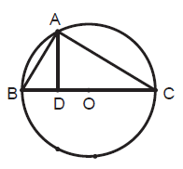
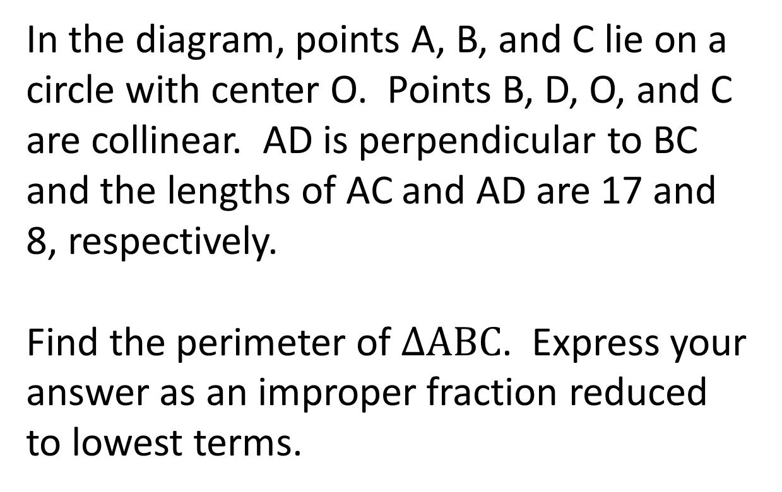
Question 4 (NO CALCULATORS)
In the diagram, points A, B, and C lie on a circle with center O. Points B, D, O, and C are collinear. AD is perpendicular to BC and the lengths of AC and AD are 17 and 8, respectively.
Find the perimeter of $∆ABC$. Express your answer as an improper fraction reduced to lowest terms.

Slide 15
Question 4 (Answer)
136/3
You may use calculators beginning with the next question.

Slide 16
Question 5 (CALCULATORS ALLOWED)
In a class of 25 students, a subgroup of 15 students scored an average of 72 on a math test. The overall class average was 76. What was the average score of the remaining 10 students?

Slide 18
Question 5 (Answer)
82

Slide 19
Question 6 (CALCULATORS ALLOWED)
The first term of a geometric sequence is equal to the first term of an arithmetic sequence, and the fourth terms of each sequence are also equal. The common ratio of the geometric sequence is 2.
If the first term is an integer, and the common difference d of the arithmetic sequence is an integer such that 0 < d < 54, find the largest possible acceptable value of d.

Slide 21
Question 6 (Answer)
49

Slide 22
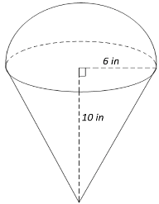
Question 7 (CALCULATORS ALLOWED)
An ice cream cone has base-radius 6 units and height 10 units. The cone is filled with ice cream, which also extends from the top of the cone in the shape of a perfect hemisphere.
Calculate the total volume of the ice cream cone and its contents. Give an approximate decimal answer rounded to the nearest tenth.

Slide 24
Question 7 (Answer)
829.4

Slide 25
Question 8 will be the final question. Proctors will keep and total your answer sheets after you submit this question.
Please remain in your seats until totals have been verified, as ties among the top three positions would be broken with tie-breaker questions.

Slide 26
Question 8 (CALCULATORS ALLOWED)
Tennis balls come only in boxes of 7 and 16. Thus, if you wanted 19 balls, you could not get 19 exactly with any combination of whole boxes of balls. Let k be the largest number of balls you could not get exactly with some combination of whole boxes of balls.
A tennis net consists of strings that form layout consists of a rectangular grid of 6912 squares. If the net pattern has between 20 and 30 squares in height, let w be the sum of all possible integer values for the number of squares representing its height. Find k + w.

Slide 28
Question 8 (Answer)
140
This ends the competition unless there are ties; please remain while proctors total the scores.

Slide 30
Tiebreaker 1 (CALCULATORS ALLOWED)
The lengths of all sides of a right triangle are whole numbers. If the length of one side of the triangle is 12, find the largest possible value of the perimeter of the triangle.

Slide 32
Question T1 (Answer)
84

Slide 33
Tiebreaker 2 (CALCULATORS ALLOWED)
A coin flip will be used before a baseball game to determine the home team. Unbeknownst to the players, the coin will flip heads with probability 1/3 and tails with probability 2/3. One of the players is asked to “call” the flip.
What is the probability he calls the flip correctly? Give your answer as a reduced fraction.

Slide 35
Question T2 (Answer)
1/2

Slide 36
Tiebreaker 3 (CALCULATORS ALLOWED)
A sum of $5,000 is invested and grows to $24,000 in 10 years, compounded quarterly. As a percentage, what annual interest rate was applied? Give your answer rounded to the nearest whole number.

Slide 38
Question T3 (Answer)
16

Slide 39
Tiebreaker 4 (CALCULATORS ALLOWED)
What is the units digit of (67)²⁰²⁵?

Slide 41
Question T4 (Answer)
7

