Slide 1
Perception Problems
Vision understanding, natural language processing and speech recognition all have several things in common
  each problem is so complex that it must be solved through a series of mappings from subproblem to subproblem
  we have little useful information for how humans solve the problems so knowledge acquisition and knowledge-based construction approaches may or may not be of any value
  solving the problem can benefit greatly from worldly knowledge but there is too much to easily place into a perceptual problem solver
  each problem contains some degree of uncertainty and therefore solutions that handle uncertainty (HMMs or neural networks) might be preferred

Slide 2
Computer Vision is More Challenging
SR and NLU pose unique challenges but there is in essence one goal for SR (recognizing words) and generally one goal for NLU (obtaining a meaning)
In vision, there are many different goals that we might try to solve
  recognizing characters
  recognizing faces
  recognizing if something is a certain shape or not (e.g., counting the number of people at a location)
  looking for obstacles or keeping inside a lane (e.g., for an autonomous vehicle)
  comprehending an input (identifying all the objects)
These different problems may try to use different forms of input (e.g., bitmap, laser, infrared, xray)

Slide 3
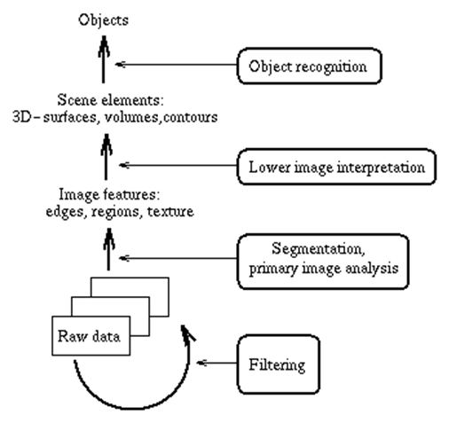
Vision Understanding Mapping
As with SR/NLU, we will solve the general vision problem through a series of mappings
  low level processing and filtering
  pixels → edges/lines and other “low level” features (blobs, corners, points)
  edges/lines → regions
  regions → surfaces
  add texture, shading, contours
  surfaces → objects
  classify objects
  analyze scene (if necessary)

Slide 4
Some Details
Computer vision has been studied for decades
  there is no overarching solution to the problem (similar to there not being a single solution to NLU)
  each of the mappings has its own solution
    often mathematical
    often applies constraint satisfaction algorithms to reduce search
  the “intelligence” part really comes in toward the end of the process
    object classification
    scene analysis
    surface and object disambiguation (determine which object a particular surface belongs, dealing with optical illusions)
Computer vision is practically an entire CS discipline

Slide 5
Feature Detection
Unlike SR where features are pulled from a processed speech signal, visual features can vary (lines, edges, points, corners, blobs, ridges, etc)
There are different mathematical approaches to handling each different form of feature
  line derivatives, detection of light intensities, distance computations, vector multiplication, integration, various forms of Gaussian computations (Laplacian of the Gaussian, Difference of the Gaussian), wavelets, …
Detecting features also varies based on the type and quality of the input
  is the input a well-defined set of pixels or some image in which a pixel may or may not be part of a line?
  before we even try to extract features, we may need to “smooth” pixels through some form of statistical/probabilistic filter (e.g., a Gaussian kernel)

Slide 6
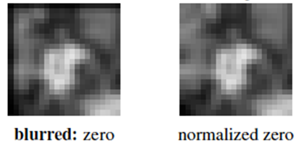
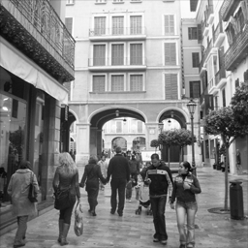
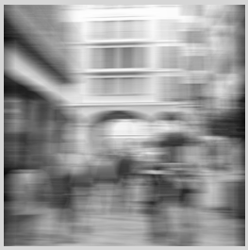
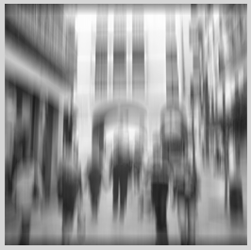
Blurring to Find Edges
use a vertical filter and a horizontal filter separately and then combine

Slide 7
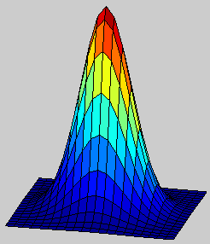
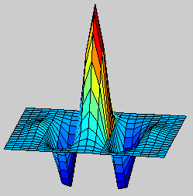
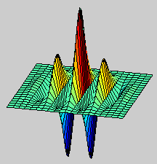
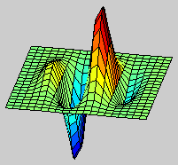
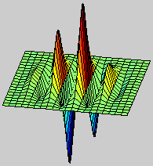
What is a Wavelet?
u₀=0
U₀=0.1
U₀=0.2

Slide 8
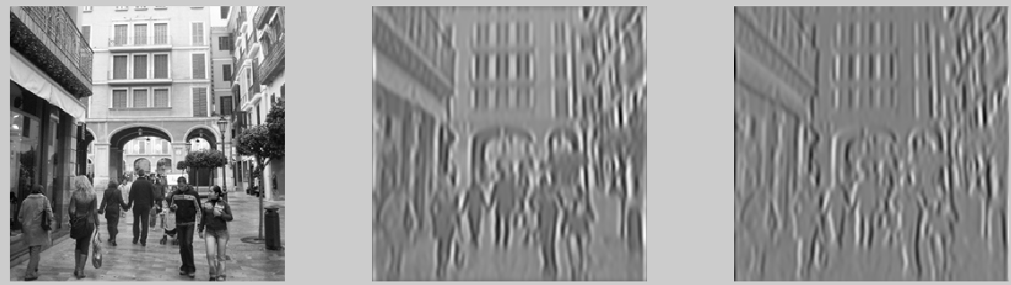
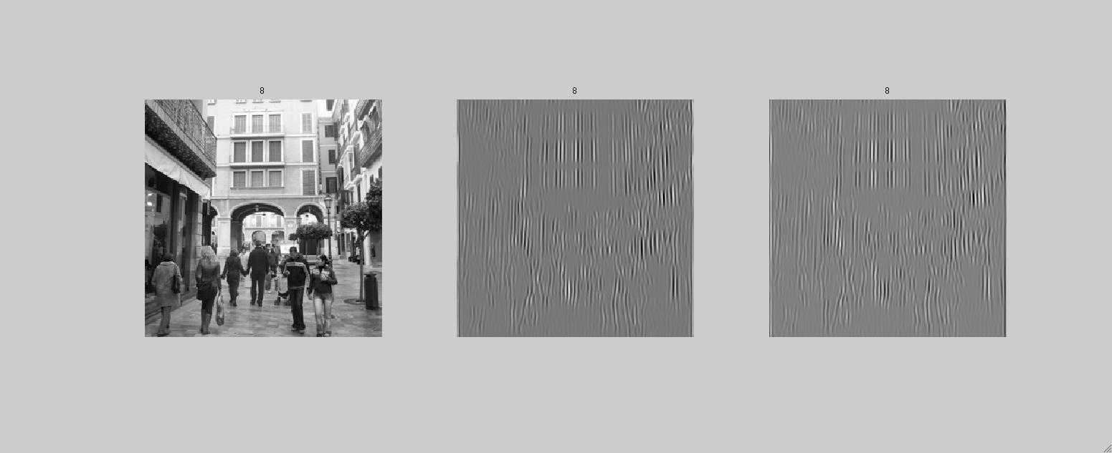
Applying Wavelets

Slide 9
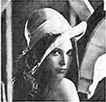






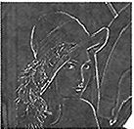
Applying a Laplacian Gaussian
reduce
reduce
reduce
expand
expand
expand

Slide 10
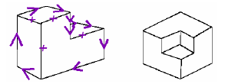
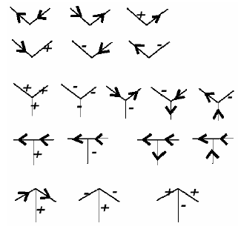
Using Edge Detection
Waltz’ algorithm
  uses edges to find junction points (intersections of edges)
  determines the orientation of the lines into the junction points
  applies constraint satisfaction to select which lines belong to which surfaces
    below, convex edges are denoted with + and concave edges with -
Other approaches may be necessary for
curve, contour or blob detection and analysis
Use mathematical models like eigen-models
(eigenform, eigenface), quadratics, distance
measures, closest point computations, etc

Slide 11
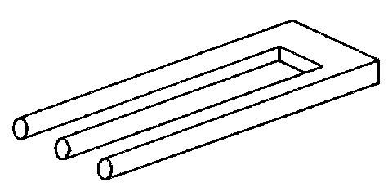
Complexity of Waltz
There are 27 different types of junction points
Each junction has on average 4.5 different possible interpretations
Testing the combination means 4.5²⁷ for each junction in the figure! (this is a number greater than 1 quadrillion!)
We need constraints to reduce this search
The devil’s trident optical illusion
could take a computer a million
years to properly recognize the edges

Slide 12
Surface Detection
Waltz’ algorithm helps determine what edges go with a specific surface
We also need to factor in shades, texture, light, etc
  does surface A touch surface B? are the two surfaces part of the same object? is a surface partially occluded?
Surface detection requires
  selecting the specific points/lines/edges of interest
  segmenting those lines into distinct surfaces
  connecting surfaces into distinct objects
There are highly specialized mathematical algorithms for surface detection
  note these do not take into account any knowledge of surfaces (for instance, we are looking at a sink with a hole in the middle)

Slide 13
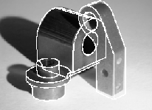
Surface Detection Example
Our computer vision system must deal with overlapping items
  notice how the shape on the right is partially occluded
  This requires reasoning about 3-D space with a 2-D image
And must not be confused by shadows
  texture, light intensity comes into play

Slide 14
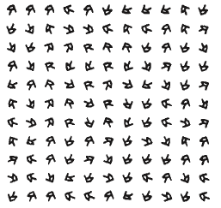
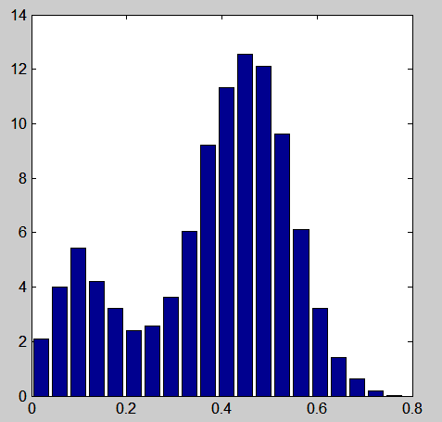
Handling Textures
Perform a comparison of different regions to find similar patterns of textures (light intensities)
Represent these comparisons
Generate a histogram to be used for matching

Slide 15
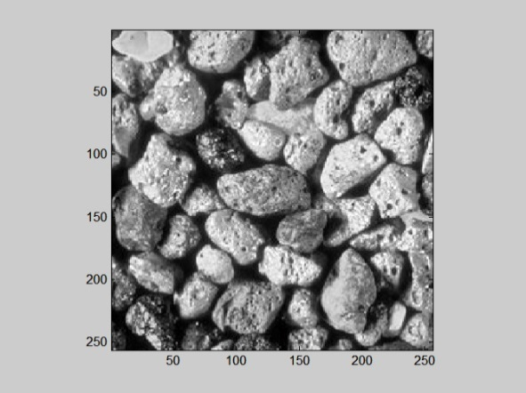
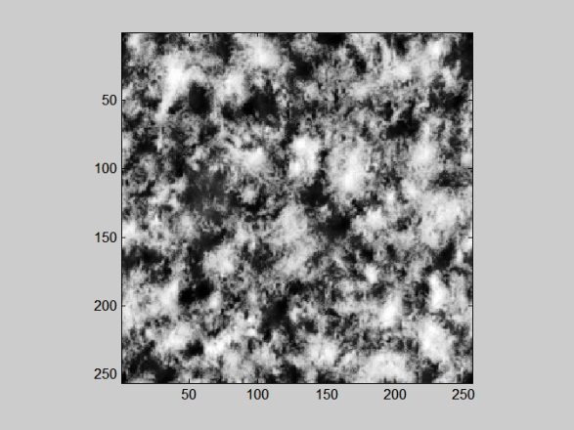
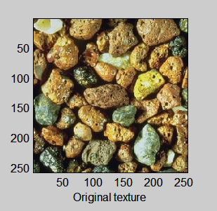
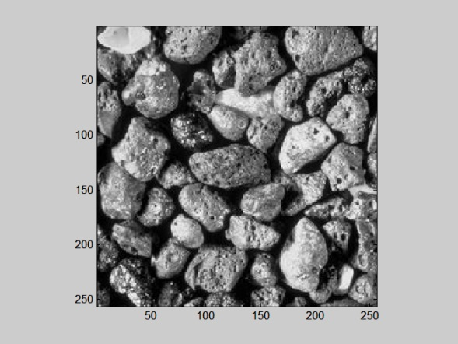
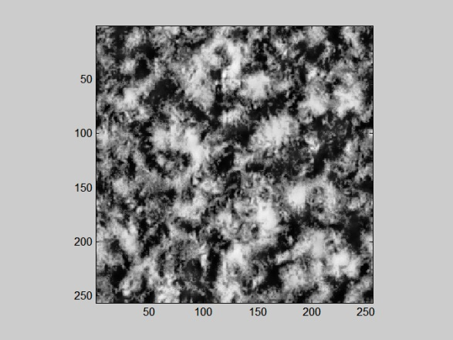
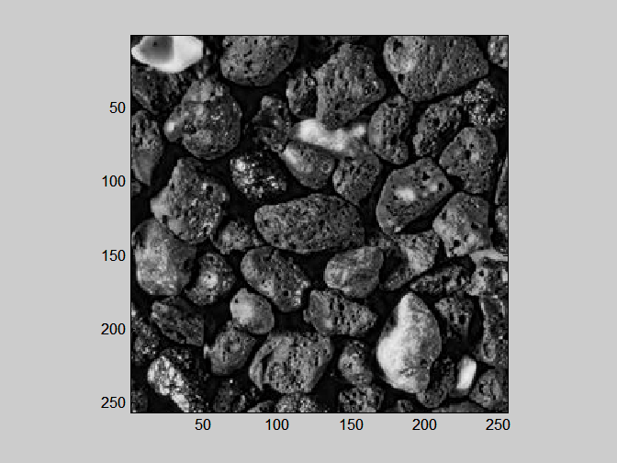
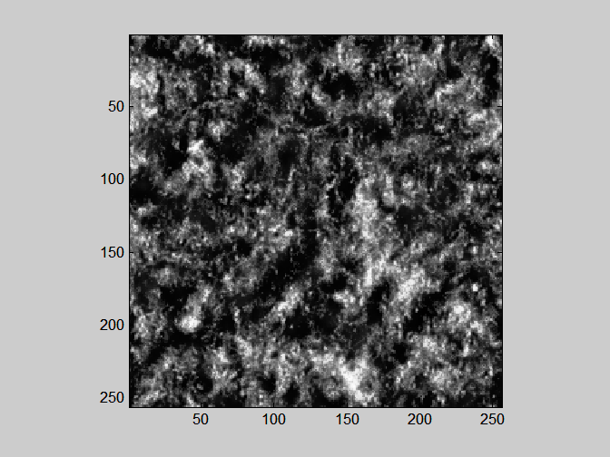
Textures by Color
R
G
B

Slide 16
Object Identification
Once we have a description of the surfaces, we now must identify the object
Any number of techniques could be applied where the input is the set of surfaces (rather than the bitmaps)
  HMMs
  neural networks
  symbolic forms using rules
  SVMs (one per object type)
Different strengths and weaknesses for these including whether the approach can learn
Usually limited to a particular class of objects (domains) for simplicity

Slide 17
Character Classification
Once we have edges determined, we can attempt to classify objects
  Symbolic approaches can look for collections of edges (e.g., a “4” would have a vertical line with a diagonal line from one end to the midway point and a horizontal line connecting that diagonal to the vertical)
  Even classification printed characters requires a great many rules
  We also have to worry about orientation (are we looking at the “4” right side up?)
Neural networks have been used which bypass the previous levels and take as input the bitmap and classify the character
  The neural network can handle obscured images or images with the wrong orientation

Slide 18
Continued
Machine produced character recognition has been satisfactorily solved using neural networks
Printed character recognition has high accuracy also often using neural networks but can also be solved using nearest-neighbor mathematical approaches and SVMs
  pre-processing includes de-skewing, despeckling, line removal and normalizing the characters
Hand-written character recognition has much lower accuracy and has many more challenges, similar to moving from discrete SR to continuous
  recurrent neural networks are a common solution
The problem becomes much more challenging moving away from English characters

Slide 19
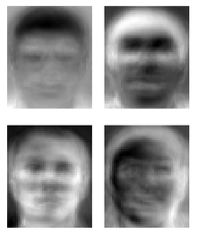
Facial Recognition
Often uses a combination of feature extraction and distance vectors
  locate the nose and lips
  how far is the nose from the upper lip?
  locate the eyes
  how wide are they? how far apart are they?
For each face in our database, store these distance vectors using eigenfaces, HMM probabilities, or other representations
  Note that these approaches are require proper orientation – if we train an eigenface vector with the face looking straight ahead, what happens if we have an image of the face to the side?
More recent approaches include skin texture analysis to add color/texture to the process

Slide 20
Autonomous Vehicles
How much vision does an AV need?
  to keep between the lines of a road, it needs to be able to detect lines (solid and dashed)
  in poor light and in good light
  when lines are clearly visible (e.g., freshly painted) and when marginally available (e.g., faded, partially obscured by dirt, tar, etc)
AVs need collision detection
  lasers have been employed rather than cameras for frontal collision detection
    can detect an object and possibly even its size and shape but this is not an image
  what about side and rear collision detection? cameras or other forms of sensors?

Slide 21
Video Object Identification
When we add a video component, we might shift from identifying the scene to looking for a particular type of object
  A video surveillance system might look for human motion while ignoring motion of smaller things like cats, dogs, rabbits, etc
  A smart weapon, when dropped from an airplane, should be able to recognize a tank from above without confusing it with a school bus!
Here, we are less interested in identifying a specific object or instance, more interested in a gross level of classification
  However, this may be combined with face recognition to identify people of interest in a location like an airport

