Slide 1
Instruction Set Principles
Fixed-length vs variable-length instruction format
Load-store instruction set or not
Number of operands
  two operand instructions or three operand instructions or both?
    one operand instructions are generally a thing of the past
  number of registers?
  size of immediate datum?
Memory issues
  what addressing modes?
  size of displacement?
Types of instructions
  conditional instructions?
Other
  condition codes testing status flags

Slide 2
Comparison of Instruction Lengths

Slide 3
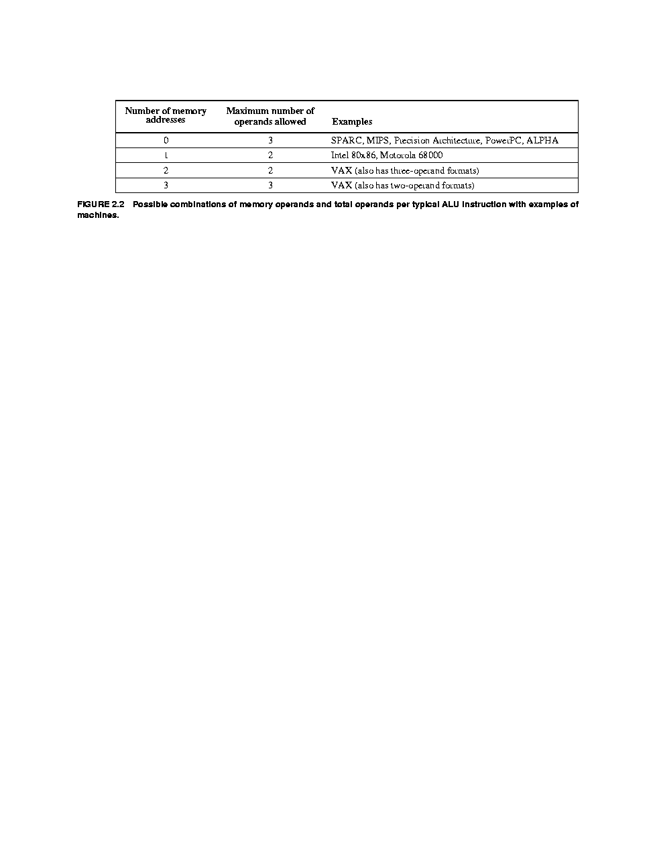
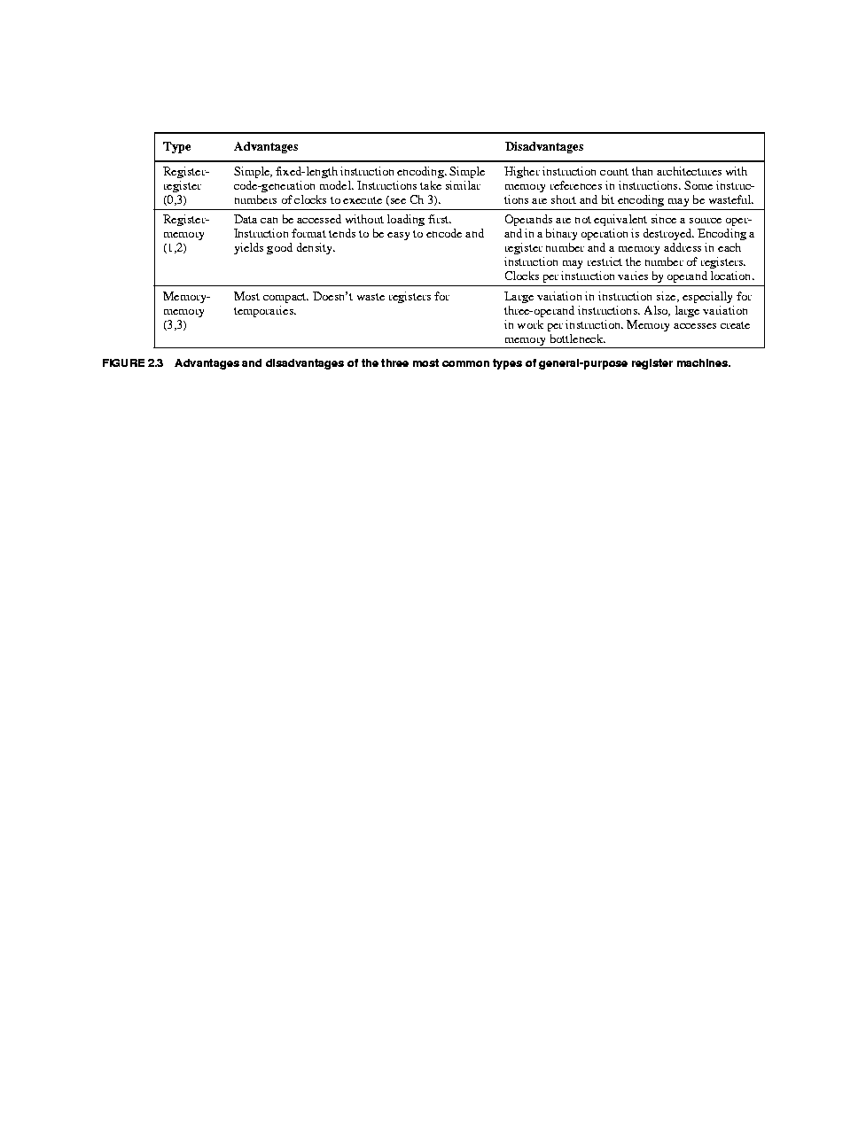
Comparison of # of Operands

Slide 4
Addressing Modes
Data will either be
  constants (immediate data)
  stored in registers
  stored in memory
If memory, several ways to specify address
  direct
  indirect (pointers)
  register indirect (pointer moved to register)
  base displacement/indexed (address = base + displacement)
    usually one value is stored in a register, the other is specified as part of the instruction or stored in another register
    may use a scaling factor on the displacement

Slide 5
% Addressing Mode Use in 3 Benchmarks

Slide 6
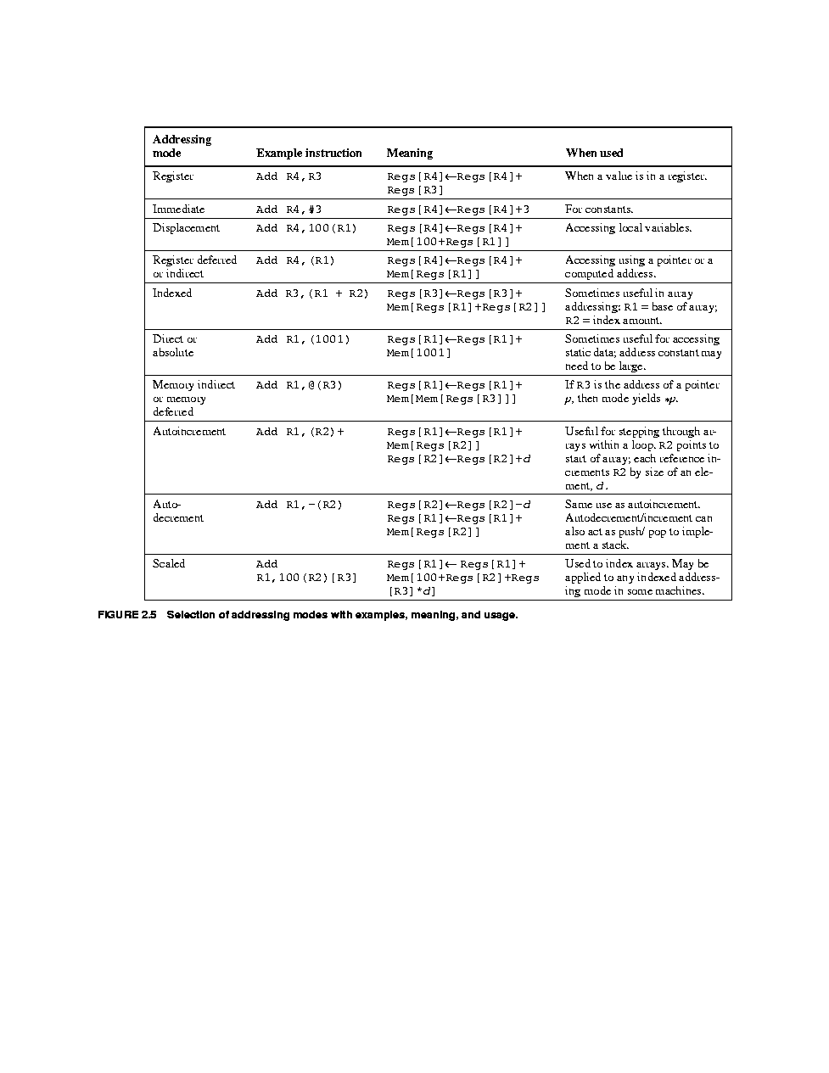

Slide 7
Addressing Mode Design Issues
How many bits should be allowed for an immediate datum
How many bits should be allowed for a displacement?
  analysis of SPEC benchmarks indicate no more than 15 bits are typically needed for a displacement (displacements are < 32K)
  8 bits for most immediate data
Which modes?
  analysis of SPEC benchmarks indicates that immediate and base-displacement modes are most common
  with base displacement, we simulate direct by having a displacement of 0
  with base displacement, we simulate register mode by having a base of 0

Slide 8
Branch Issues
Usually PC-relative branching
  PC ← PC + offset
  this shortens instruction lengths as the instruction only has to specify the offset rather than a full memory address
  offsets can be positive (branching forward) or negative (branching backward)
Type of branches
  conditional branches (test condition to decide whether to branch)
  unconditional branches
  branch and link (subroutine calls, returns)
  traps (branch and link to the OS)
    the last two categories require parameter passing
    using register windows eliminates the need for time-consuming memory accesses
  conditional branches make up 75-82% of all branches

Slide 9
Continued
What is condition type in conditional branches?
  complex conditions can be time consuming
  condition codes is problematic with pipelines
  simple zero test (value == 0 or value != 0) is the fastest approach but requires additional instructions
When is the comparison performed?
  with the branch instruction or prior to the branch?

Slide 10
Types of Instructions
Integer arithmetic and logic operations
  * and / may be including as part of the FP arithmetic requiring conversion between int and FP values (and converting the result back to int)
  load immediate may also be considered integer as this loads an immediate datum into a register and so does not require memory access
  about 22% of all loads are load immediate operations
FP arithmetic (+, -, *, /), also FP/int conversion
Data transfer (loads, stores)
  may have several different types for different data types and different addressing modes
Control (conditional/unconditional branches, calls/returns, traps)
Other
  I/O
  strings operations (move, compare, search)
  OS operations (OS system calls, virtual memory, other)
  Graphics operations (pixel operations, compression/decompression, others)

Slide 11
RISC-V
We will use the RISC-V instruction set in this class
  a descendant of the earliest RISC instruction sets like MIPS
  4 types of instructions

Slide 12
A Closer Look at Load/Store Operations
Format is operation destination, displacement(base)
  the base is a register storing the base of the address
  the displacement is a 12-bit signed int value
    gives us a range of -2048 to +2047
Three addressing modes available
  register indirect – use a displacement of 0
  direct – use a base of 0 by specifying a special register that always stores 0 (x0)
  base-displacement – use both
Other modes can be simulated with multiple instructions
  indirect – do two loads, first load the pointer and then load the datum
  indexed – add the index register to the base register, use sum as the register with a displacement of 0
  scaled – store the index in a register, shift it, add it to the base, use a displacement of 0
  autoincrement/decrement – add index register to base register, use a displacement of 0, increment/decrement the index register

Slide 13
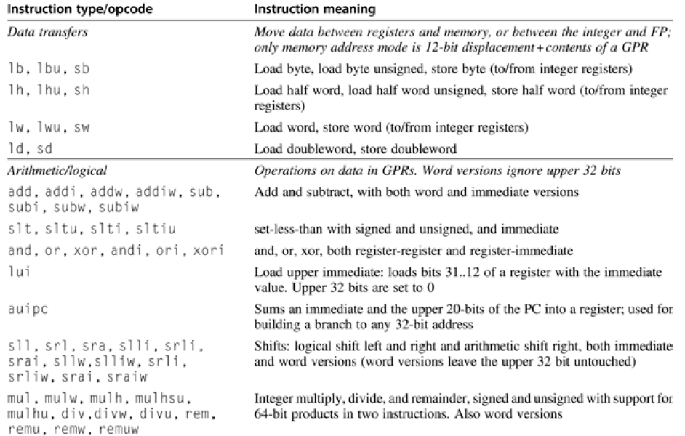

Slide 14
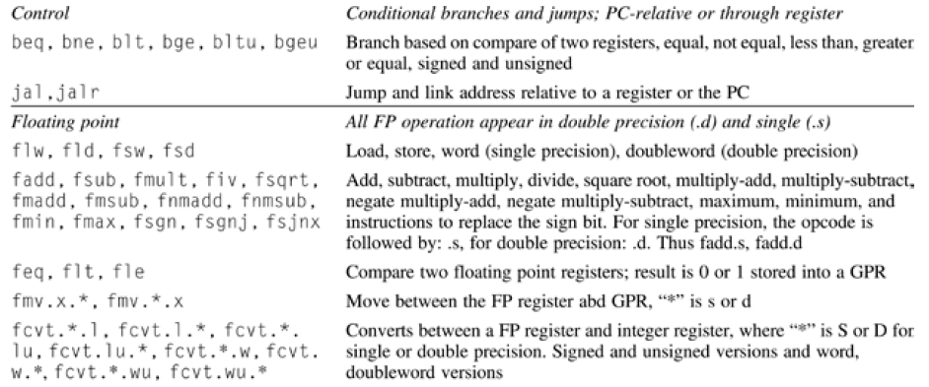

Slide 17
RISC Architecture Addressing Modes
NOTE: RV64G
is RISC-V
Letters are
the data
sizes permitted
B = byte
H = half word
W = word
D = double (long)

Slide 18
RISC-V Continued
RISC-V registers
  32 integer registers: x0-x31, x0 is always 0
  32 FP registers: f0-f31
  all registers store 64 bits, if the datum is 32 bits, half the register is unused
  there is also a special purpose register used to store FP status information
Data sizes
  8-bit, 16-bit, 32-bit (word size), 64-bit (double word)
  when stored in registers, 8 and 16-bit values are sign extended to 32 bits

Slide 19
Benchmark Breakdown of Instructions

Slide 20
RISC-V 5-Stage Architecture
From Appendix C section C.1

Slide 21
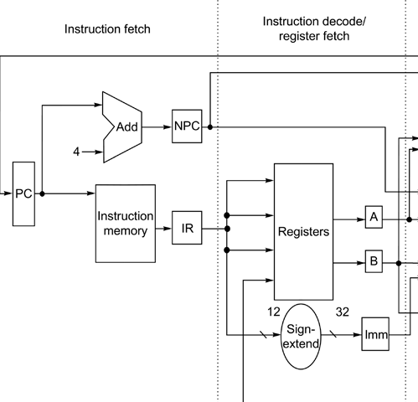
IF & ID Stages
IF:
  PC sent to instruction cache
  PC incremented by 4, stored in NPC temporarily
    a MUX in the MEM stage determines if the PC should get the value in NPC or the value computed in EX
  Instruction stored in IR
ID:
  Bits 15..19 denote one source register (I-type, R-type, S-type instructions)
  Bits 20..24 denote one source register (R-type, S-type)
  Bits 20..31 (I-type) or 12..31 (U-type) store immediate datum or displacement, sign extended to 32 bits
    note: for S-type, the immediate datum is split across bits 7-11 and 25-31
NPC, A, B and IMM are temporary registers used in later stages

Slide 22
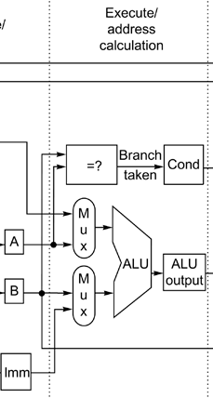
EX Stage
This stage
  executes ALU operations
    using register A & B or A& IMM, result from ALU placed in ALU output register and passed on to next stage
  computes effective addresses for loads and stores
    A + IMM, stored in ALU output and passed onto next stage
  computes branch target locations and performs the zero test to determine if a branch is taken or not
    A zero tested
    ALU adds PC + IMM, value sent to ALU output and passed to next stage

Slide 23
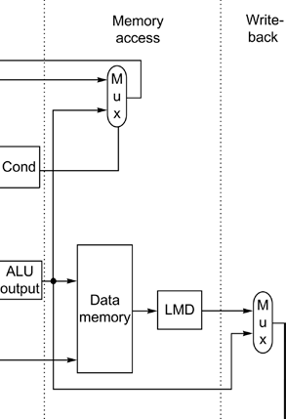
MEM and WB Stages
MEM:
  If load, ALU output stores address, sent to data cache, resulting datum stored in LMD
  If store, ALU output stores address and B register stores datum, both are sent to data cache
  If branch, based on condition, MUX either selects NPC or branch target location (as computed in the ALU EX) to send back to PC
  If ALU operation, forward result from ALU output directly to WB stage
WB:
  If a datum in LMD (load from a load), store in the register file, if datum forwarded from ALU output from EX stage, store in the register file

Slide 24
Analysis
CPI:
  Loads, ALU – 5 (require WB stage)
  Stores, branches – 4 (do not require WB stage)
PC is modified by either
  the value in the NPC (PC + 4)
  the value coming from the ALU output if the condition tested in EX is true
B and IMM get a datum no matter what type the instruction
  the decision on which register to use (B/IMM) is made by the MUX in the EX stage
Bits from the op code in the IR are sent to the various MUXes to decide which input to pass on as output
  A or NPC
  B or IMM
  NPC or PC+IMM (from ALU in EX stage)
  LMD or ALU output for register file
  MUX in register file (not shown in figure) selects appropriate register to use (for A/B or result)

Slide 25
Fallacies and Pitfalls
P: Designing high-level instruction set features to support high-level language features (e.g., Intel’s loop instruction) – this will likely cost you more than its worth especially if you try to pipeline the instruction set
F: There is no such thing as a typical program – programs vary dramatically in memory usage, I/O, integer computation, FP computation, use of branches, etc
P: Innovating at the ISA to reduce code size without accounting for the compiler
F: An architecture with flaws cannot be successful – they cite the x86

