Slide 1
Instruction-Level Parallelism
ILP is the exploitation of using parallel hardware (usually in the form of a pipeline) to execute multiple instructions at a time
  as we saw in appendix C, this gives us a speedup with little cost
To support ILP, we need
  parallel hardware – the pipeline for instance
  logic in the hardware to prevent hazards from producing incorrect code
  compiler support to take advantage of the parallel hardware

Slide 2
Limitations on ILP
Consider the following for-loop where a is a double array and c is a double
  for(i=0;i<n;i++) a[i] = a[i] + c;
This code becomes the following RISC-V code
There will be a 1 cycle stall after the fld, 3 cycles of stalls after the fadd.d, a 1 cycle stall after the subi and the branch delay slot
  with compiler scheduling, the best we can do is to have 1 stall if we allow the fadd.d and fsd to enter MEM at the same time)
loop: fld f0, 0(x1)
fadd.d f4, f0, f2
fsd f4, 0(x1)
subi x1, x1, #8
bne x1, x2, loop

Slide 3
A Solution
Loop unrolling
  with this strategy, the loop body is repeated several times per iteration
  this provides more instructions to schedule to reduce the number of stalls
  the loop mechanism is still performed one time
Loop unrolling can be handled by the compiler
  static scheduling
Or by hardware
  dynamic scheduling

Slide 4
Static Loop Unrolling
When the compiler determines there are not enough instructions within a loop’s body to schedule out the stalls, it can attempt to unroll the loop
Loop unrolling works as followed
  1. reduce a loop of n iterations to a loop of n / k iterations by repeating the loop body k times
    NOTE: the loop mechanism itself is only used once per iteration
  2. revise memory references as needed
    first iteration would reference memory location 0(x2), the second then might reference memory location 4(x2), the third 8(x2)
  3. update loop variable incr/decr by factor of k
  4. use the extra instructions to schedule away all stalls

Slide 5
Example
loop: fld f0, 0(x1)
fadd.d f4, f0, f2
fsd f4, 0(x1)
subiw x1, x1, 8
bne x1, x2, loop
loop: fld f0, 0(x1)
fadd.d f4, f0, f2
fsd f4, 0(x1)
fld f0, 8(x1)
fadd.d f4, f0, f2
fsd f4, 8(x1)
fld f0, 16(x1)
fadd.d f4, f0, f2
fsd f4, 16(x1)
addiw x1, x1, 24
bne x1, x2, loop
loop: fld f0, 0(x1)
fld f6, 8(x1)
fld f8, 16(x1)
fadd.d f4, f0, f2
fadd.d f10, f6, f2
fadd.d f12, f8, f2
addiw x1, x1, 24
fsd f4, -24(x1)
fsd f10, -16(x1)
bne x1, x2, loop
fsd f12, -8(x1)
NOTE: adjusted destination
registers to avoid WAW hazards,
adjusted offsets based on where
the addiw appears
Solution on page 179-180 shows unrolling this loop 4 times
instead of 3 but does not fill the branch delay slot

Slide 6
More on Loop Unrolling
We assumed n is divisible by 3 when we unrolled the loop 3 total times
  if n = 100, we would still have 1 extra iteration to perform
  we handle this with one more iteration of the loop body
    before or after the loop
We may also be restricted by the number of registers
  assume the code performed FP * instead of FP +
  we would need to unroll the loop 6 total times
  we would need 13 FP registers instead of 7
    would we have enough?
Aside from filling all stalls, we get a side benefit
  fewer total instructions executed
    one subiw and bne per 3 iterations

Slide 7
Revisiting Dependencies
Before we look at dynamic scheduling, let’s revisit the forms of dependencies
  data – also known as true dependencies
    datum required for instruction j is being produced by instruction i earlier in the instruction stream
    e.g., loading from memory and then using the loaded datum in an ALU operation or computing a value in an ALU operation to be used in a later ALU or store
    handled via forwarding when possible, stalls when not
  name – two instructions reference the same named entity but there is no flow between them (not a data dependent)
    two forms: antidependence and output dependence (see next slide)
  control – dependencies on what instructions should execute based on branches
    must be properly handled when there is branch speculation and exceptions

Slide 8
More On Name Dependencies
Antidependence
  later instruction writes to register/memory earlier than earlier instruction reads the datum (WAR hazard)
  not possible in the 5-stage pipeline or the extended FP pipeline
  possible with dynamic scheduling
    the unrolled loop example has an antidependence on x1 between the fsd’s and the subiw
    by moving the subi earlier, we had to adjust our fsd’s
Output dependence
  later instruction writes to register/memory earlier than earlier instruction writes (WAW hazard)
We handle these types of dependencies through renaming one of the items

Slide 9
Dealing With Control Dependences
In our 5-stage pipeline, branches resulted in a 1 cycle penalty that we could try to fill with a neutral instruction
  given that we tend to not have branches more often than every few instructions, we could usually fill the branch delay slot
With dynamic issue superscalar pipelines (we visit this later in these notes), we will find that we could literally reach a branch in nearly every cycle
  we need a better approach to dealing with branches
We use some form of branch prediction, also known as speculation
Two approaches
  static branch prediction by accumulating statistics of how our branches behaved in previous runs, stored in a buffer (cache)
  hardware branch prediction where the latest branch result(s) is(are) stored in a buffer (cache)

Slide 10
Correlating Branch Predictors
In Appendix C, we looked at simple 1-bit and 2-bit predictor schemes
  the problem is that the prediction is based solely on earlier behavior of the same branch
A better predictor might include the result of other branches
  there’s a poor example on page 183 where the third branch will be taken if the first two branches are not taken
A correlating (or 2-level) predictor can provide more accurate predictions
  top level contains the locations of various predictors based on the result of more than one branch
  based on the top level, a different prediction is consulted
  both the top level and the branch predictor can be altered over time

Slide 11
Continued
An (m, n) predictor uses the behavior of the last m branches
  to choose from 2^{m} branch predictors
  each branch predictor is an n-bit predictor
A (1, 2) predictor only uses the behavior of the last branch and selects a 2-bit predictor, this is what we had previously
A (2, 2) predictor might be useful for the example on page 183 (see the next slide)
  we can predict if(aa!=bb) based on the result of whether aa==2/aa!=2 and bb==2/bb!=2
An (m, n) predictor requires a buffer of 2^{m} * n * k bits
  k is the number of branches we are storing predictions of
  a (2, 2) prediction scheme for 1K branches would take 2² * 2 * 1K = 8Kbits or 1KByte
    remember, this is stored in an on-chip cache

Slide 12
Example
subiw x3, x1, 2
bne x3, x0, L1
addw x1, x0, x0
L1: subiw x3, x2, 2
bne x3, x0, L2
addw x2, x0, x0
L2: sub x3, x1, x2
beq x3, x0, L3
…
j elsewhere
L3: …
if(aa==2)
aa=0;
if(bb==2)
bb=0;
if(aa!=bb) …
If the first two conditions are
true, we know the third condition
must be false – thus, the third
condition has a correlation with
the first two conditions

Slide 13
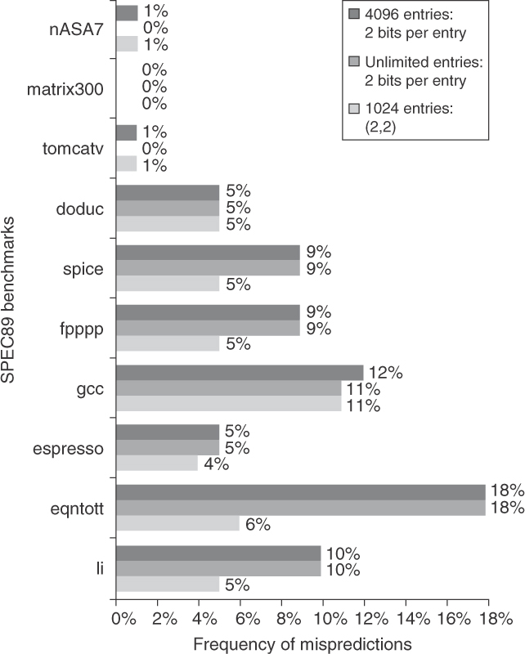
Tournament Predictors
Tournament prediction extends correlating predictors by having multiple predictors per branch
  at least one global and one local
  prediction created by combining various predictors
    see the next slide
  the graph on the right compares 2-bit predictor schemes
    the top two being non-correlating predictors of 4096 and unlimited entries
    the bottom being a (2, 2) correlating predictor using both local and global data

Slide 14
Implementing a Tournament Predictor
We maintain a branch history
  results of previous branch decisions
    not this branch, all branches
This branch’s address sent to branch prediction buffer
  the local predictor
Branch’s address also sent to a selector buffer to select whether to use the global predictor or local predictor
  selector buffer bases its decision on the most recent prediction(s) of this branch to indicate which predictor is more reliable
We can achieve reasonable prediction
accuracies with a modest sized overall
buffer of between 1K-4Kbytes using
1024 2-bit entries in each of the three
buffers

Slide 15
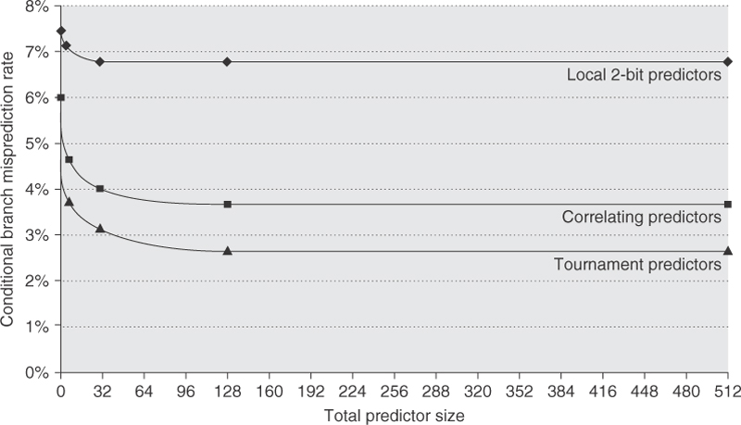
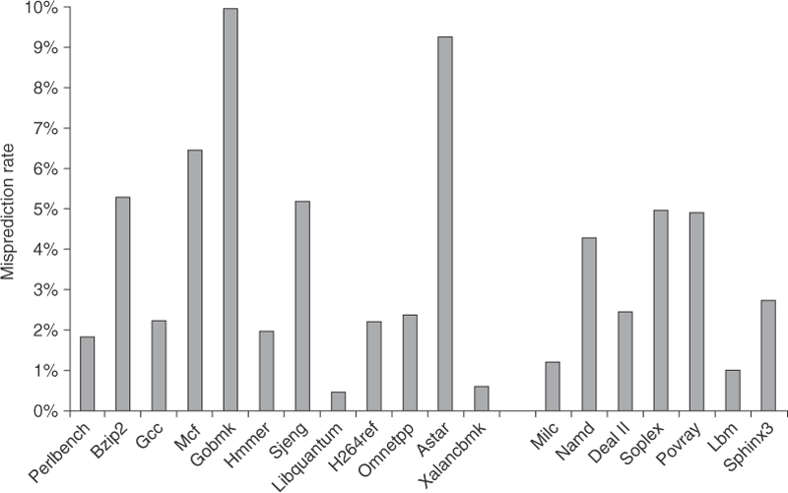
More Results
Miss-prediction rates given
total predictor size and
type of predictors
Overall miss-prediction rate
FP predictions are more
accurate than int predictions
probably because there are
more and lengthier loops in
FP benchmarks

Slide 16
Tagged Hybrid Predictors
The most accurate predictors to date
  global predictors only
    maintain a list of the last i branches for a given branch instruction
    use a shift register
    shift the oldest result away when inserting the newest branch result
  use multiple predictor tables, each stores a 2-bit prediction
  index into each table using the branch instruction’s address and the last j bits of the history (j varies by table)
    table 0 uses no history, table 1 uses a 1-bit history, table 2 uses a 2-bit history, etc
  accessing a table may result in a cache miss because the address matched but the history did not
    use the prediction from the table that matched the longest history, using table 0’s prediction as the default (if no others match)
  this approach apparently has the best prediction results without requiring a great deal of storage

Slide 18
Intel Core i7 Branch Prediction
The i7 has a deep pipeline and uses multiple instruction issue (superscalar)
  as many as 256 instructions might be in the pipeline
    fetched, issued and waiting at reservation stations, being executed, finishing execution and waiting to forward results, forwarding results
  as a result, branch prediction is critical
  the i7 920 uses a tournament predictor combining a 2-bit prediction, a global history, and a loop exit predictor
    this last predictor uses a counter to predict the number of loop iterations, indicating an exit if the counter exceeds the predicted number of iterations
  the i7 6700 appears to use a tagged hybrid predictor which improves prediction accuracy by about 25%
    see figure 7.9 page 192

Slide 19
Dynamic Scheduling
Hardware handles when instructions are issued to execute rather than using the compiler’s ordering
  fetch instructions as scheduled by the compiler
  issue instructions to hardware units when those hardware units become available
  obtain operand information once all operands for the instruction become available
  when the hardware unit produces a result, send it to the register file and forward it to waiting instructions
First implemented in the CDC 6600 in the late 1960s using a piece of hardware called the scoreboard
  scoreboard keeps track of which instructions are issued to the various hardware units and tracks data dependencies (for forwarding or stalling purposes)

Slide 20
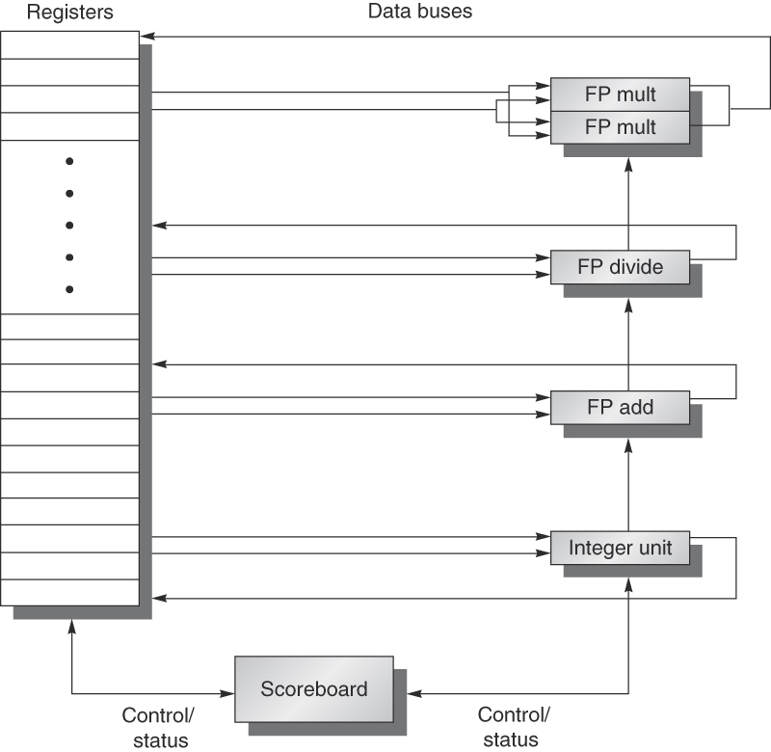
The New Pipeline
IF stage is the same
ID stage is now:
  decode/issue
    send instruction to proper functional unit if available
    track data dependencies, manipulate scoreboard
  read operands
    if operands available in register file, obtain them
    otherwise wait until for operands to become available (forwarded from other functional unit(s))
    operands are not read until all are available
  functional units write directly to register file and forward results
    thus eliminating the WB stage
Add functional units as available
(for instance, have multiple
FP *, FP +, FP /, integer units)

Slide 21
Issuing Logic
Given an instruction, examine its
  source registers
    do either values need to be forwarded from other functional units?
  destination register
    does the result get forwarded to another functional unit?
  determine any WAR or WAW hazards
  instruction type
    is the needed functional unit available?
If functional unit available and no other active instruction has the same destination register (that is, no WAW hazard detected), then issue the instruction
  if no functional unit is available or a WAW hazard exists, postpone issuing the instruction
    results in stalling the IF/ID portions of the pipeline

Slide 22
Advantage of Dynamic Scheduling
Only stall instructions because of functional unit limitations or WAW hazards
RAW hazards do not stall the IF/ID stages so other, later instructions, can still be fetched, issued and if data are available, executed
  in the 5-stage pipeline, a RAW hazard stalls the current instruction (usually between IF and ID) which stalls fetching the next instruction
  here, RAW hazards cause an instruction to wait at a functional unit without stalling later instructions (unless they need the same functional unit)
  thus, we have an improved performance

Slide 23
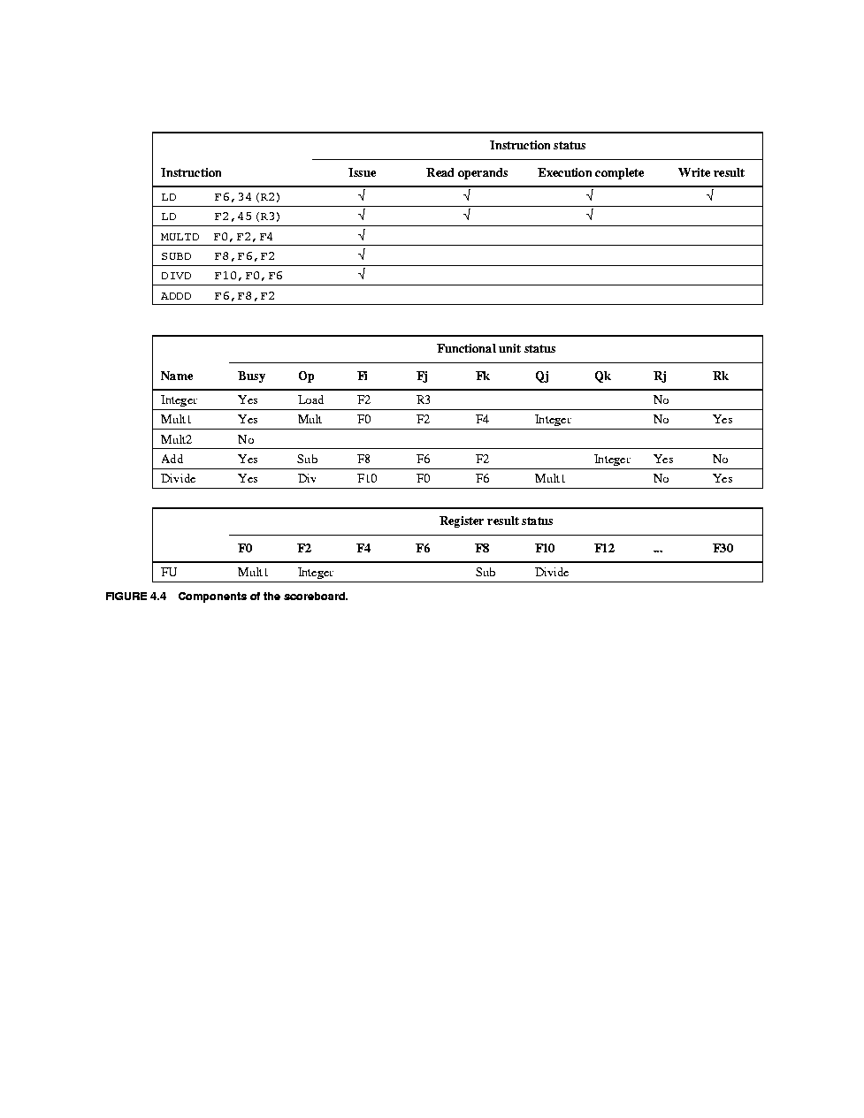
Scoreboard Structure
Scoreboard hardware stores three types of information
  Instruction status
    for each instruction, which stage it is in currently
  Functional unit status
    for each functional unit, its status, destination and source register names, boolean flags to indicate whether the source values are available yet
  Register result status
    for each register, which functional unit might be writing to it

Slide 24
How the Scoreboard Works
IF stage
  same as in the pipeline, just fetch next instruction
Issue stage
  decode instruction from IF stage
  if functional unit is available and destination register does not have a pending result (WAW hazard), issue instruction
  set functional unit’s info in the scoreboard as follows
    Busy ← ‘yes’
    OP ← operation
    Fi ← destination register, Fj/FK ← source registers
    Qj/Qk ← functional unit producing source registers (if any)
    Rj/Rk ← is source value available yet? (yes/no)
  result register status for Fi ← functional unit name

Slide 25
Continued
Read operands
  occurs at the functional unit when Rj & Rk are set to yes resulting in the following changes
    Rj/Rk ← ‘no’, Qj/Qk ← 0, Fj/Fk ← values
  one limitation is that only one functional unit can read its registers in any given cycle
Execution takes place in the functional unit
  execution begins as soon as Fj/Fk have values
  upon completion, scoreboard updates state of Execution Complete
Write result
  after execution is complete, if no WAR hazards exist, then send result to result register and any waiting functional units whose source register equals the result register
    update scoreboard setting busy ← ‘no’
    functional unit becomes available

Slide 26
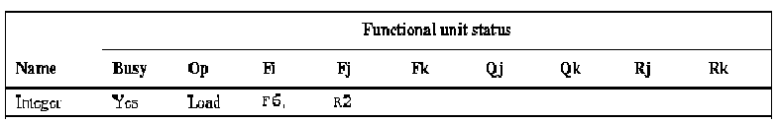
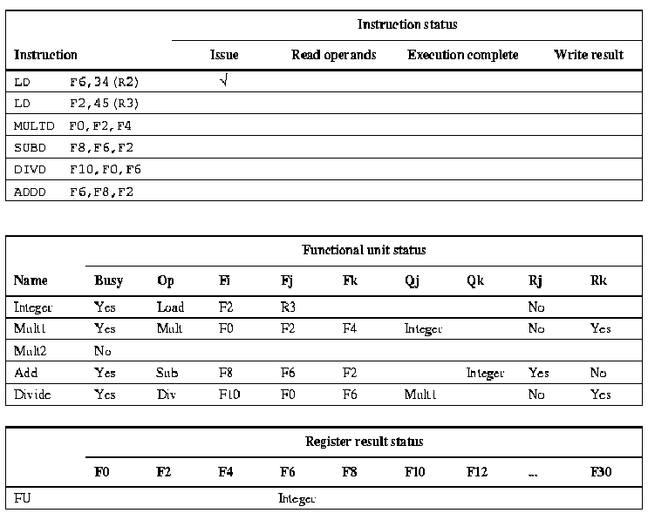
Example
Assume the following
Execution time in cycles:
Add = 2
Multiply = 10
Divide = 40
Register write and register read of same register occur in separate cycles
Only 1 FU can read operands at a time
Number of FUs:
1 int unit
1 FP divider
2 FP multiplier
1 FP adder
Cycle 1
NOTE: this code is old, assume LD = fld, MULTD = fmult.d,
SUBD = fsubd, DIVD = fdiv.d, ADDD = fadd.d

Slide 27
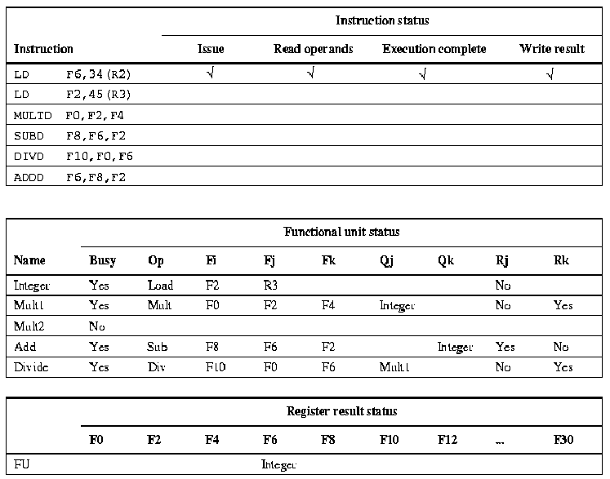
Cycles 2-4
Second LD cannot issue because the Integer functional unit is busy, scoreboard tracks the first LD as it goes through read operands, execution and write result stages

Slide 28
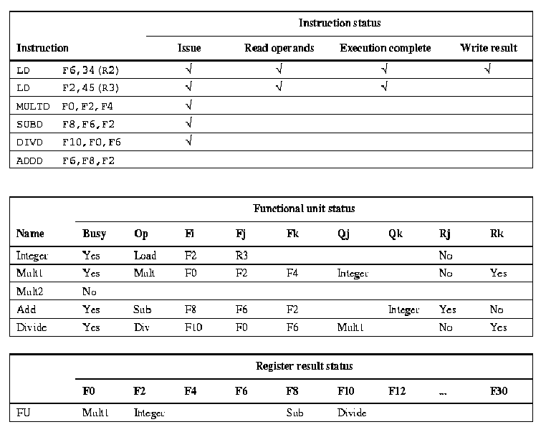
Cycles 5-8
Cycle 5: second LD is issued
Cycle 6: MULTD is issued, LD reads operands
Cycle 7: SUBD is issued, LD executes load, MULTD cannot yet read operand F2 (F0 is ready but not yet read)
Cycle 8: second LD’s writes results, MULTD waiting to read F2, SUBD waiting to read F2, DIVD is issued

Slide 29
Cycles 9-15
Cycle 9: MULTD reads its registers, SUBD has to wait (only 1 functional unit can read registers at a time), DIVD waits for F0 from MULTD, ADDD cannot be issued (FP adder is busy)
Cycle 10: MULTD begins execution, SUBD reads registers, DIVD continues to wait for results, ADDD still not issued
Cycle 11: SUBD begins execution, MULTD continues execution, DIVD waits, ADDD not yet issued
Cycle 12: SUBD continues execution, MULTD continues execution, DIVD waits, ADDD not yet issued
Cycle 13: ADDD can be issued now that SUBD has left its functional unit, MULTD continues, DIVD still waiting
Cycle 14: ADDD reads operands, MULTD continues execution DIVD waits
Cycle 15: ADDD begins executing, MULTD continues execution, DIVD waits

Slide 30
Cycles 16-62
Cycle 16: ADDD continues, MULTD continues, DIVD waits
Cycle 17: ADDD wants to write its results but there’s a WAR hazard with the DIVD, so even though ADDD has finished executing, it must remain in the FP adder, waiting to submit its results
Cycle 18-19: ADDD remains at functional unit, MULTD continues execution, DIVD waits
Cycle 20: MULTD writes results, ADDD remains, DIVD waits
Cycle 21: DIVD reads its operands, ADDD remains
Cycle 22: DIVD begins execution, ADDD can finally write to the register file and leave the scoreboard
Cycles 23-61: DIVD continues execution
Cycle 62: DIVD writes result

Slide 31
Benefits and Costs of the Scoreboard
Benefits
  instructions can continue to be fetched and issued when there are RAW hazards
Costs
  extra logic, data storage for the scoreboard itself
  primarily cost is in added buses to permit forwarding from functional unit to every other functional unit and register file
    about 4 times as many buses as in an ordinary pipeline
Restrictions
  only so much parallelism (functional units) available
  logic and added hardware take up space, will limit the size of the scoreboard which itself limits the number of functional units we can add
  WAW and WAR hazards still stall instructions but at their FUs

Slide 32
Register Renaming
We can avoid name dependencies (WAW and WAR hazards) to some extent by not referencing the same register across instructions
  we need to detect that two instructions have a name dependence (same named register) but not a data dependence (not a true or RAW dependence)
  to implement this, modify the scoreboard concept to a slightly different approach whereby register numbers are dynamically generated rather than statically selected by the compiler
  known as Tomasulo’s approach

Slide 33
Dynamic Scheduling
Distribute previous 5 stage pipeline differently
  IF
    as before, instructions scheduled by compiler, fetched one per cycle and placed into an instruction queue, stalling if queue becomes full
  ID
    separate into issue and read operand stages as with the scoreboard
  EX
    distribute to functional units
    each functional unit has its own sets of registers to store multiple waiting instructions
    functional units are pipelined to allow multiple instructions to use the same functional unit rather than waiting at a time
  MEM
    separate out this stage into load buffer and store buffer
    buffers are queues of waiting instructions, waiting to do a load or store
  WB
    values forwarded directly from functional unit to functional unit, store buffer and register file via a common data bus

Slide 34
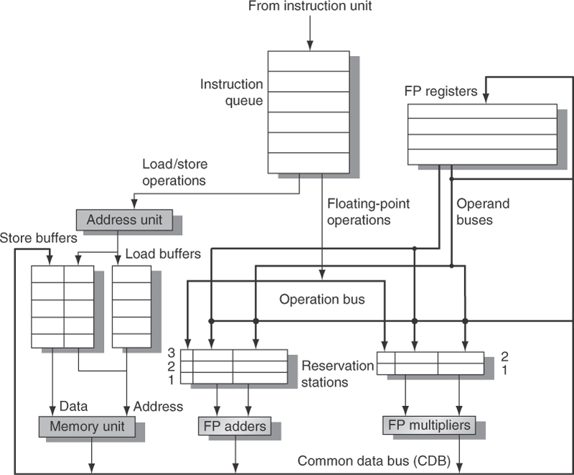
Tomasulo’s Architecture

Slide 35
Revised Stages
Issue
  take next instruction from instruction queue
  decode it
  if reservation station is available for the needed functional unit, issue it to that reservation station, otherwise, stall
Read operands
  operands forwarded from Load unit, register file or other functional unit to reservation station
    unlike scoreboard, values forwarded when available
    no waiting for both operands to become available before reading
    reservation station stores operation, location of operand sources and location for result
  instructions wait at reservation stations and can execute out of order based on order that operands are received
  register renaming is applied dynamically in the reservation stations to avoid WAR and WAW hazards
    see the example on the next slide

Slide 36
Register Renaming Example
In the code to the right
  f0 causes RAW hazard between fdiv.d and fadd.d, f6 causes RAW hazard between fadd.d and fsd
    nothing can be done about these
  f6 causes WAW hazard between fadd.d and fmult.d
  f8 causes WAR hazard between fadd.d and fsub.d
Rename f6 to S between fadd.d and fsd
  does not prevent the RAW hazard, but prevents the WAW hazard
We rename f8 to T between fsub.d and fmult.d
  removes WAR hazard with fadd.d
fdiv.d f0, f2, f4
fadd.d f6, f0, f8
fsd f6, 0(x1)
fsub.d f8, f10, f14
fmult.d f6, f10, f8
fdiv.d f0, f2, f4
fadd.d S, f0, f8
fsd S, 0(x1)
fsub.d T, f10, f14
fmult.d f6, f10, T
As long as S continues to be
used for f6 and T continues
to be used for f8, there is no
problem with this renaming

Slide 37
Stages Continued
Execution
  operands forwarded to reservation station
    once operands are available, execution begins in functional unit
    multiple instructions waiting for the same operand can begin execution in the same cycle (the cycle after the datum is forwarded)
      this gets around one of the major restrictions with the scoreboard where only one instruction could read registers per cycle
    when two instructions are waiting at the same functional unit, if operands become available at the same time for both, an instruction is selected randomly to begin execution
      except for loads/stores which are handled in order
      note that if the functional units are pipelined, another instruction can begin execution at the next clock cycle
  an instruction control dependent on a condition is not allowed to execute until the condition has been confirmed

Slide 38
Continued
Write result
  once a functional unit has completed its execution (or a load unit has received its datum from cache), the value is forwarded over the CDB
  only one CDB and only one write per cycle
    if multiple functional units/load unit have a result ready in the same cycle, the results are sent out sequentially, one per cycle
  CDB forwards result to waiting reservation stations, store buffer (if items is to be sent to memory) and register file
    the single CDB becomes a bottleneck here much like reading operands was a bottleneck in the scoreboard

Slide 39
How Register Renaming Works
Register renamer (hardware) is added to the issue stage
  maintains list of temporary registers, called T registers, and a rename table
  table keeps track of renamed registers for the remainder of the code that would reference the original register
If destination register will cause a WAW or WAR hazard, then the renamer
  substitutes destination register with next available T register
  adds the original register and new register name to register table
For every new instruction’s source register
  if it matches an entry in the table, replace it with the corresponding T register
  requires examining the table each cycle
  architecture might have as many as 64 T registers
  registers are rotated (when a register is no longer in use, it becomes available to be reused)
  table itself is a simple hardware-stored vector

Slide 40
Example
    fld f4, 0(x1)
fmult.d f2, f0, f4
fdiv.d f8, f4, f2
fld f4, 0(x5)
fadd.d f6, f0, f4
fsub.d f8, f8, f6
fsd f8, 0(x5)
To resolve the WAW hazards,
registers are dynamically renamed
fld T9, 0(x1)
fmult.d f2, f0, T9
fdiv.d T10, T9, f2
fld T11, 0(x5)
fadd.d f6, f0, T11
fsub.d T12, T11, f6
fsd T12, 0(x5)
Consider the code to the right
  there is a possible WAW hazard with f4 between the two fld’s (this in fact does not arise because the first fld will complete before the second, plus f4 is read by fmult.d and fdiv.d
  there is a WAW hazard on f8 between the fdiv.d and fsub.d
  how will register renaming operate assuming that the next available T register is T9?
If this code were in a loop, each successive iteration
of the loop will continue to use additional T
registers, the next iteration will use T13-T16,
followed by T17-T20, etc, if we reach T63,
we cycle around to T0

Slide 41
Example
Instruction |  | Issue | Execute | Write Result
fld | f6, 32(x2) | *
fld | f2, 44(x3)
fmult.d | f0, f2, f4
fsub.d | f8, f2, f6
fdiv.d | f10, f0, f6
fadd.d | f6, f8, f2
fld f6, 32(x2)
fld f2, 44(x3)
fmult.d f0, f2, f4
fsub.d f8, f2, f6
fdiv.d f10, f0, f6
fadd.d f6, f8, f2
Name | Busy | Op | Vj | Vk | Qj | Qk | A
Load1 | yes | Load |  | x2 |  |  | 32+Regs[x2]
Load2
Add1
Add2
Add3
Mult1
Mult2
Assume execution
times of 4 cycles so
that FP – FP delays
are 3 cycles and
FP – store delays
are 2 cycles
The WAR hazard on f6
in the fadd.d is handled
by renaming that register
Field |  | F0 | F2 | F4 | F6 | F8 | F10
Qi |  |  |  |  | Load1

Slide 42
Continued
Name | Busy | Op | Vj | Vk | Qj | Qk | A
Load1 | yes | fld |  | x2 |  |  | 32+Regs[x2]
Load2 | yes | fld |  | x3 |  |  | 44+Regs[x3]
Add1 | yes | fsub.d |  |  | Mem[44+Regs[x3]] | Mem[32+Regs[x2]]
Add2
Add3
Mult1 | yes | fmult.d |  | Regs[f4] | Mem[44+Regs[x3]]
Mult2
With register renaming, we would expand the result register status
to include temporary registers (in this example, the fadd.d, issued
probably to the Add2 FU would be listed under a temporary register,
say T0
Field |  | F0 | F2 | F4 | F6 | F8 | F10
Busy |  | Mult1 | Load2 |  | Load1 | Add1

Slide 45
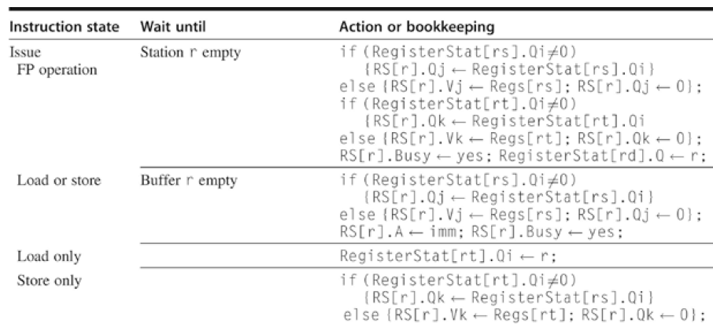
Tomasulo Logic

Slide 46
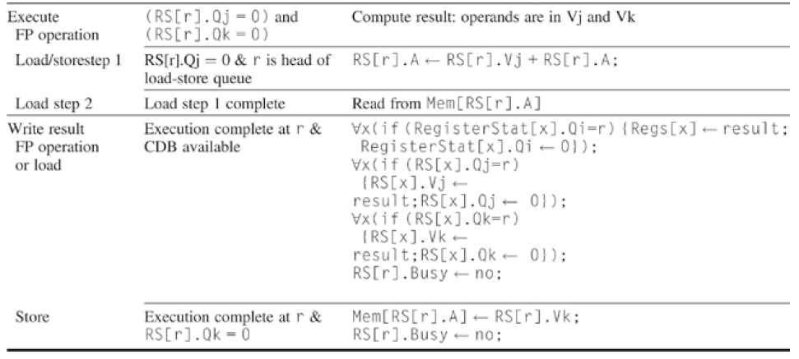

Slide 47
Dynamic Loop Unrolling
The Tomasulo architecture improves over the Scoreboard
  instructions do not stall because of WAW hazards and can complete in spite of WAR hazards
  multiple instructions can read operands in one cycle (when forwarded)
  multiple reservation stations get around function unit structural hazards, again, reducing stalls
  instructions are sent to reservation stations as soon as they reach the front of the instruction queue (unless all reservation stations of a FU are occupied)
Compared to compiler scheduling
  instruction fetch and issue do not stall upon RAW hazard
Aside from increased cost (more registers, a scoreboard), there is a disadvantage
  compiler-based loop unrolling removed several branches (although this is mitigated with successful branch speculation)

Slide 48
Continued
Loop unrolling can be handled by the hardware by continuing to issue instructions of successive loop iterations as they are reached in the instruction stream
  an excessive number of WAR and WAW hazards can cause us to run out of temporary registers if we have too many loop iterations running at once
  although compiler-based loop unrolling used just as many or more registers, but in this case “real registers” (instead of temporary registers) as named by the compiler
  how many iterations can we accommodate in the Tomasulo architecture? this depends on number of T registers and number of reservation stations
  in our previous example, we used 4 T registers per iteration and had 64 T registers limiting us to 16 loop iterations (64 is a sufficient number unless we are dealing with long instructions like divides)

Slide 49
Example
Loop: | fld | f0, 0(x1)
 | fmult.d | f4, f0, f2 |  | RAW hazard with fld
 | fsd | f4, 0(x1) |  | RAW hazard with fmult.d, which will take several cycles
 | subiw | x1, x1, -8
 | bne | x1, x2, Loop |  | RAW hazard with subiw
 |  |  |  | Branch hazard
Here is the similar loop to the one we unrolled by compiler
The fmult.d’s latency causes stalls that cannot be removed through
instruction scheduling because there are not enough instructions
available
Loop unrolling and scheduling resolves all stalls

Slide 50
Tomasulo Solution
Instruction |  |  | Issue | Execute | Write Result
fld | f0, 0(x1) |  | *
fmult.d | f4, f0, f2
fsd | f4, 0(x1)
fld | T0, 0(x1)
fmult.d | T1, T0, f2
fsd | T1, 0(x1)
Name | Busy | Op | Vj | Vk | Qj | Qk | A
Load1 | yes | Load |  | x1 |  |  | Regs[x1] + 0
Load2 | no
Add1 | no
Add2 | no
Add3 | no
Mult1 | no
Mult2 | no
Store1 | no
Store2 | no
Field |  | F0 | F2 | F4 | F6 | T0 | T1
Busy |  | Load1

Slide 51
Continued
Instruction |  |  | Issue | Execute | Write Result
fld | f0, 0(x1) |  | * | * | *
fmult.d | f4, f0, f2 |  | *
fsd | f4, 0(x1) |  | *
fld | T0, 0(x1) |  | *
fmult.d | T1, T0, f2
fsd | T1, 0(x1)
Name | Busy | Op | Vj | Vk | Qj | Qk | A
Load1 | yes | Load |  |  |  |  | Regs[x1] + 0
Load2 | yes | Load |  | x1 |  |  | Regs[x1] - 8
Add1 | no
Add2 | No
Add3 | no
Mult1 | yes | MUL |  | Regs[f2] | Load1
Mult2 | no |  |  | Regs[f2] | Load2
Store1 | yes | Store | Regs[x1] |  |  | Mult1
Store2 | no
Field |  | F0 | F2 | F4 | F6 | T0 | T1
Busy |  | Load1 |  | Mult1 |  | Load2

Slide 52
Continued
Instruction |  |  | Issue | Execute | Write Result
fld | f0, 0(x1) |  | * | * | *
fmult.d | f4, f0, f2 |  | * | *
fsd | f4, 0(x1) |  | *
fld | T0, 0(x1) |  | * | *
fmult.d | T1, T0, f2 |  | *
fsd | T1, 0(x1) |  | *
Name | Busy | Op | Vj | Vk | Qj | Qk | A
Load1 | no
Load2 | Yes | Load |  | R1 |  |  | Regs[x1] - 8
Add1 | no
Add2 | no
Add3 | no
Mult1 | yes | MUL |  | Regs[f2]
Mult2 | yes | MUL |  | Regs[f2] | Load2
Store1 | yes | Store | Regs[x1] |  |  | Mult1
Store2 | yes | Store | Regs[x1]-8 |  |  | Mult2
Field |  | F0 | F2 | F4 | F6 | T0 | T1
Busy |  |  |  | Mult1 |  |  | Mult2

Slide 53
Continued
Instruction |  |  | Issue | Execute | Write Result
fld | f0, 0(x1) |  | * | * | *
fmult.d | f4, f0, f2 |  | * | * | *
fsd | f4, 0(x1) |  | * | *
fld | T0, 0(x1) |  | * | * | *
fmult.d | T1 T0, f2 |  | * | ----
fsd | T1, 0(x1) |  | *
Name | Busy | Op | Vj | Vk | Qj | Qk | A
Load1 | no
Load2 | no
Add1 | no
Add2 | no
Add3 | no
Mult1 | no
Mult2 | yes | MUL |  | Regs[f2] | Load2
Store1 | no
Store2 | yes | Store | Regs[x1]-8 |  |  | Mult2
Field |  | F0 | F2 | F4 | F6 | T0 | T1
Busy |  |  |  |  |  | Load2 | Mult2

Slide 54
Summary on Tomasulo
Notice we unrolled the loop two times and the hardware was able to execute two iterations
  the only hazards were RAW dependencies
  the WAW hazard between the two iterations’ F0 and F4 were handled by renaming these registers to T0 and T1, and by modifying the register result table
  assuming the multiplier units are pipelined, we could have accommodated even more iterations of the loop
Note if memory access causes a stall because of a cache miss, the hardware can continue issuing instructions which can then execute out of order
  also notice that compiler optimizations are no longer essential to obtain performance increases

Slide 55
Continued
The main bottleneck for Tomasulo is a single CDB
  we can improve on this by having an FP CDB and an int CDB
  we cannot have two FP CDBs because the functional units need to watch the CDB for values it is waiting on
Other limitations are
  number of FUs and number of reservation stations at each FU
  if FUs are not pipelined
  single data accesses (loads/stores) per cycle
  added cost in logic to look for potential WAR/WAW hazards and perform register renaming

Slide 56
Hardware-based Speculation
Now that we are exploiting more ILP with dynamic scheduling and loop unrolling
  we need to ensure control dependencies are maintained
Hardware-based speculation combines
  dynamic branch prediction to select what instruction to fetch next
  speculation to allow predicted instructions to execute and complete even if the condition on which the instruction is dependent has not yet been evaluated
  a mechanism to “undo” the results of a completed speculated instruction in case the prediction is wrong
In order to implement speculation, we add a new piece of hardware called the reorder buffer (ROB)

Slide 57
Re-Order Buffer
Stores all instructions issued in the order they were issued
  as opposed to the order the instructions may complete
Results of speculated instructions are not sent directly to the register file (or memory)
  result stored in register in the ROB, alongside its instruction
When an instruction reaches the front of the ROB
  if not speculated, submit results (write to registers, memory) and let instruction leave ROB
  if branch or instruction speculated because of branch, wait until result of branch is known (stalls the ROB)
    upon learning result of condition, if speculated correctly remove instruction and submit results (register, memory, waiting reservation stations) but if miss-speculated, remove from ROB along with all instructions after it, discarding any results

Slide 58
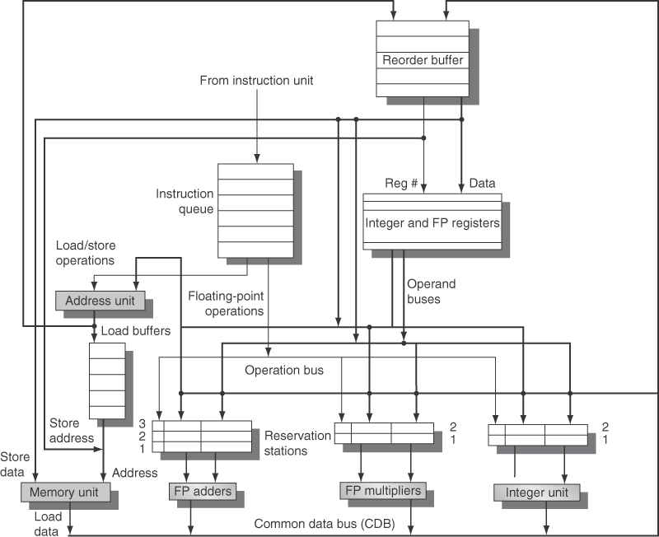
Superscalar Tomasulo + ROB

Slide 59
New Implementation
Instructions fetched as before
Upon decoding instruction, if space available in both reservation station of functional unit and ROB
  handle any register renaming to avoid detected WAW/WAR hazards
  issue instruction to both reservation station and ROB
    this stage stalls if no available reservation stations OR no available slot in the ROB
Execute as before
New stage: Commit
  instruction at front of ROB is committed if it was speculated correctly (or not speculated at all)
  ROB forwards result to register file and/or store unit and instruction leaves ROB
  otherwise, instruction and all that follow are flushed

Slide 60
Example

Slide 61
Loop Unrolling Example

Slide 62
Integer Example
Cycle | Instruction | Issue | Exec | Mem Acc | CDB | Commit | Comments
1 | lw x2, 0(x1) | 1 | 2 | 3 | 4 | 5 | First issue
1 | addiw x2, x2, 1 | 1 | 5 |  | 6 | 7 | Wait for LD
1 | sw x2, 0(x1) | 2 | 3 |  |  | 7 | Wait for add
1 | addiw x1, x1, 4 | 2 | 3 |  | 4 | 8 | Commit in order
1 | bne x2, x3, Loop | 3 | 7 |  |  | 8 | Wait for add
2 | lw x2, 0(x1) | 4 | 5 | 6 | 7 | 9 | No delay
2 | addiw x2, x2, 1 | 4 | 8 |  | 9 | 10 | Wait for LD
2 | sw x2, 0(x1) | 5 | 6 |  |  | 10 | Wait for add
2 | addiw x1, x1, 4 | 5 | 6 |  | 7 | 11 | Commit in order
2 | bne x2, x3, Loop | 6 | 10 |  |  | 11 | Wait for add
3 | lw x2, 0(x1) | 7 | 8 | 9 | 10 | 12 | No delay
3 | addiw x2, x2, 1 | 7 | 11 |  | 12 | 13 | Wait for LW
3 | sw x2, 0(x1) | 8 | 9 |  |  | 13 | Wait for add
3 | addiw x1, x1, 4 | 8 | 9 |  | 10 | 14 | Commit in order
3 | bne x2, x3, Loop | 9 | 13 |  |  | 14 | Wait for add

Slide 63
Revised Logic

Slide 64
Continued

Slide 65
Implementation Issues
Each cycle, the hardware needs to
  fetch instruction from instruction buffer and branch prediction buffer
    apply the prediction
    update buffer on miss-predictions or buffer miss
  decode instruction, determine if reservation station and ROB slot are both available
    handle WAW/WAR hazard through register renaming
    issue instruction to reservation station and ROB
  once operands forwarded to reservation station, begin executing instruction in functional unit
    assuming another instruction waiting in the same functional unit is not starting at the same time
  upon functional unit completion, if CDB is not busy then send result on CDB (which also goes to ROB)
  commit next instruction in the ROB if eligible
    forward data to register/store units

Slide 66
Variation: Register Renaming
Recall with Tomasulo, we used register renaming to avoid WAR hazards
Instead of using a ROB, we can also handle speculation through register renaming
  a distinction is made between “architecturally visible” registers (those explicitly referenced by the code) and physical registers
  results (whether for register file or memory) are written to physical registers
  a renaming map is maintained showing the visible to physical register mappings
    a buffer is still required to store speculated instructions until speculation is confirmed, so in essence, we are removing parts of the ROB in favor of additional registers

Slide 67
Why Use Register Renaming?
The reason to go with register renaming is the commit stage is simplified
  handle the register write from the physical register to its destination (architectural register and/or memory)
  return any allocated register(s) from this instruction back to the pool
One complication is determining which registers can be freed up
  a register may be speculated
  a register may be a source for other, waiting instructions
  hardware must determine these cases when an instruction completes and is no longer speculated
    notice that WAW hazards can be handled simply by keeping the current register in the mapping table until the later instruction completes

Slide 68
Example
6 instructions issued
Mapping shows architectural registers x1, x2, x3 being stored in several
physical registers (p32 – p37)
All renaming and mapping must take place in the same cycle the
instruction was issued
Instruction commit must also occur in 1 cycle

Slide 69
Cost of Miss-speculation
The question comes down to
  is the amount of effort of executing miss-speculated instructions and the recovery process more time consuming than the time spent waiting on a branch condition’s result if we did not speculate?
No, in most cases speculation is far more effective
This is especially true of FP benchmarks
  amount of miss-speculated code is commonly below 5%
    miss-speculation in integer benchmarks can be as high as 45%
  since cleaning up after a miss-speculation is largely a matter of flushing the ROB and refilling the instruction queue, recovery itself is quick and not very complicated
    the “loss” is that we spent time filling the ROB with the wrong instructions and so now we must refill it

Slide 70
Multiple Issue
Consider having two parallel pipelines
  one FP, one integer
  if we have an int instruction and an FP instruction as our next two, they should have no dependencies
  fetch them both, issue them both
The idea behind have multiple parallel pipelines is known as a superscalar
  note that the pipelines do not have to be int/FP, but making this restriction simplifies the logic needed to detect dependencies
We can schedule instructions
  statically by having the compiler select two instructions to group together
  dynamically by retrieving 2 instructions from the instruction buffer and trying to issue them both in the same cycle

Slide 71
Example
Loop:
fld f0, 0(x1)
fld f1, 0(x2)
fadd.d f2, f0, f1
fld f3, 0(x3)
fld f4, 0(x4)
fadd.d f5, f3, f4
fsub.d f6, f5, f2
addiw x1, x1, 8
addiw x2, x2, 8
addiw x3, x3, 8
addiw x4, x4, 8
fsd f6, 0(x5)
addiw x5, x5, 8
subiw x6, x6, 1
bne x6, x0, Loop
Integer FP
Loop:
fld f0, 0(x1)
fld f1, 0(x2)
fld f3, 0(x3)
fld f4, 0(x4) fadd.d f2, f0, f1
addiw x1, x1, 8
addiw x2, x2, 8 fadd.d f5, f3, f4
addiw x3, x3, 8
subiw x6, x6, 1
addiw x4, x4, 8 fsub.d f6, f5, f2
addiw x5, x5, 8
bne x6, x0, Loop
fsd f6, -8(R5)
Stalls for single issue code: 1 after each of fld f1 and f4, 3 after the second
fadd.d, 1 after subiw, 1 in the branch delay slot, scheduling can remove many of
these stalls; static scheduling on a 2 issue superscalar (without loop unrolling),
provides the code to the right, which consists of 12 cycles of 15 instructions,
and a CPI = .8 (assuming fsub.d and fsd can enter MEM stage at the same time)

Slide 72
Another Example
Given the loop below, scheduling it for a superscalar would be futile without loop unrolling
  only FP operation has a data dependence with the instructions that precede and succeed it
  all the compiler can do is to move addiw before fadd.d, and move fsd beneath the branch
    still leaves 2 cycles of stalls before the bne to account for the latency between the fadd.d and the fsd
    to resolve this, add loop unrolling to the process, unrolling the loop 4 total times and scheduling the code
Loop: fld f2, 0(x1)
fadd.d f2, f2, f0
fsd f2, 0(x1)
addiw x1, x1, 8
bne x1, x2, Loop

Slide 73
Solution
Integer FP
Loop: fld f2, 0(x1)
fld f4, 8(x1)
fld f6, 16(x1) fadd.d f2, f2, f0
fld f8, 24(x1) fadd.d f4, f4, f0
addiw x1, x1, 32 fadd.d f6, f6, f0
fsd f2, -32(x1) fadd.d f8, f8, f0
fsd f4, -24(x1)
fsd f6, -16(x1)
bne x1, x2, Loop
fsd f8, -8(x1)
Again, assumes fadd.d and fsd
can reach mem in the same cycle
CPI for this code is 14 instructions in 10 cycles
  or 10/14 = .714
  with a superscalar that we can achieve a CPI < 1
If we unrolled the loop 3 times instead of 4, we would have wound up with 1 cycle with no int operation
  not a stall, but it impacts CPI slightly

Slide 74
Another Solution
Assume we can issue any combination of instructions (int or FP on either side of the superscalar)
  issue integer operations on both sides of the superscalar so some of the loads and stores can issue simultaneously
  unroll the loop more times (7 times now)
Instruction 1 Instruction 2
Loop: fld f2, 0(x1) fld f4, 8(x1)
fld f6, 16(x1) fld f8, 24(x1)
fld f10, 32(x1) fld f12, 40(x1)
fld f14, 48(x1) addiw x1, x1, 56
fadd.d f2, f2, f0 fadd.d f4, f4, f0
fadd.d f6, f6, f0 fadd.d f8, f8, f0
fadd.d f10, f10, f0 fadd.d f12, f12, f0
fadd.d f14, f14, f0
fsd f2, -56(x1) fsd f4, -48(x1)
fsd f6, -40(x1) fsd f8, -32(x1)
fsd f10, -24(x1) bne x1, x2, Loop
fsd f12, -16(x1) fsd f14, -8(x1)
NOTE: assumes
we can do two
reads/two writes of
memory in each
cycle
CPI = 12 / 23 = .522
(.5 is ideal for a
2-issue superscalar)

Slide 75
Dynamic Scheduling
Static issue: compiler tasked with finding instructions to schedule
Dynamic issue: instructions must already be available (fetched) to issue
  IF stage fetches 2 instructions per cycle
    will the 2 instructions be one int and one FP?
    can the hardware search through the instruction queue (the fetched instructions) to select two instructions?
    there may not be enough time for that
  instead fetch two instructions at a time and only issue them if they can be issued at the same time (e.g., one int, one FP), otherwise, issue just one
  alternatively, we eliminate the 1 int/1FP restriction
    the following example demonstrates a typical loop being dynamically unrolled and issued 2 instructions at a time

Slide 76
Example On Tomasulo
Loop # | Instr | Issues | Executes | Memory | CDB | Comments
1 | fld f0, 0(x1) | 1 | 2 | 3 | 4 | First issue
1 | fadd.d f4, f0, f2 | 1 | 5 |  | 8 | Wait for fld
1 | fsd f4, 0(x1) | 2 | 3 | 9 |  | Wait for fadd.d
1 | subiw x1, x1, 8 | 2 | 4 |  | 5
1 | bne x1, x2, Loop | 3 | 6 |  |  | Wait for subi
2 | fld f0, 0(x1) | 4 | 7 | 8 | 9 | Wait for bne
2 | fadd.d f4, f0, f2 | 4 | 10 |  | 13 | Wait for fld
2 | fsd f4, 0(x1) | 5 | 8 | 14 |  | Wait for fadd.d
2 | subiw x1, x1, 8 | 5 | 9 |  | 10 | Wait for ALU (previous subi)
2 | bne x1, x2, Loop | 6 | 11 |  |  | Wait for subi
3 | fld f0, 0(x1) | 7 | 12 | 13 | 14 | Wait for bne
3 | fadd.d f4, f0, f2 | 7 | 15 |  | 18 | Wait for fld
3 | fsd f4, 0(x1) | 8 | 13 | 19 |  | Wait for fadd.d
3 | subiw x1, x1, 8 | 8 | 14 |  | 15 | Wait for ALU
3 | bne x1, x2, Loop | 9 | 16 |  |  | Wait for subi

Slide 77
Resource Usage for Loop
Clock # | Integer ALU | FP ALU | Data cache | CDB
2 | 1/fld
3 | 1/sld |  | 1/fld
4 | 1/subi |  |  | 1/fld
5 |  | 1/fadd.d |  | 1/subi
7 | 2/fld
8 | 2/sld |  | 2/fld | 1/fadd.d
9 | 2/subi |  | 1/sld | 2/fld
10 |  | 2/fadd.d |  | 2/subi
12 | 3/fld
13 | 3/sld |  | 3/fld | 2/fadd.d
14 | 3/subi |  | 2/sld | 3/fld
15 |  | 3/fadd.d |  | 3/subi
18 |  |  |  | 3/fadd.d
19 |  |  | 3/sld

Slide 78
VLIW Approach
The compiler-based scheduling of a superscalar to the nth degree
  VLIW = Very Long Instruction Word
  idea is to issue up to 7 instructions per cycle based on the available functional unit
  compiler schedules the code
Available functional units accommodate
  up to 2 load/stores
  up to 2 FP
  up to 2 integer
  1 branch
Instructions bundled
CPU fetches and issues 1 VLIW at a time
  loop unrolling is required to support this

Slide 79
Example: 5 Instruction VLIW
Memory 1 | Memory 2 | FP 1 | FP 2 | Int
fld f0, 0(x1) | fld f6, -8(x1)
fld f10, -16(x1) | fld f14, -24(x1)
fld f18, -32(x1) | fld f22, -40(x1) | fadd.d f4, f0, f2 | fadd.d f8, f6, f2
fld f26, -48(x1) |  | fadd.d f12, f10, f2 | fadd.d f16, f14, f2
 |  | fadd.d f20, f10, f2 | fadd.d f24, f22, f2
sld f4, 0(x1) | sld f8, -8(x1) | fadd.d f28, f26, f2
sld f12, -16(x1) | sld f16, -24(x1) |  |  | subiw x1, x1, 56
sld f20, 24(x1) | sld f24, 16(x1)
sld f28, 8(x1) |  |  |  | bne x1, x2, Loop
This example does not attempt to fill the branch delay slot because we are using speculation. This code executes 7 iterations worth of the loop in only 9
cycles, providing a CPI of 9 / 23 = .39.

Slide 80
Multi-Issue Processor Approaches
Type | Issue Structure | Hazard Detection | Scheduling | Distinguishing characteristics | Examples
Super-scalar | Dynamic | Hardware | Static | In-order execution | MIPS and ARM
Super-scalar | Dynamic | Hardware | Dynamic | Some out-of-order execution, no speculation | None
Super-scalar | Dynamic | Hardware | Dynamic with speculation | Out-of-order completion, speculation | Intel Core i3/i5/i7, AMD Phenom, IBM Power 7
VLIW | Static | Software | Static | Compiler finds all hazards | TI C6x
EPIC | Static | Software | Static | same | Itanium

Slide 81
Supporting Superscalar
By expanding our architecture to a superscalar, we confront a serious problem
  branches make up 16% of an average benchmark
  assuming a uniform distribution of instructions, branches occur every ~6 instructions
    for FP benchmarks, it may be more like every 8-9 instructions
  there is not enough instructions between branches to obtain enough instructions to issue multiple instructions per cycle
  loop unrolling is one approach to handle this, but in general, to support multiple issue, we need instruction speculation
    that is, we need to speculate which instruction(s) should next be fetched and/or scheduled

Slide 82
How Much Can We Speculate?
Speculation requires having several instructions in the instruction queue
  use an instruction fetch unit (covered in a few slides) and a wide bus to fetch several instructions at a time
  it may require non-blocking caches or caches that can respond with multiple refill lines per cycle
Logic to issue instructions requires searching through a group of instructions for instructions that can be issued at the same time
  reservation station availability
  no resource conflicts, e.g, two memory reference instructions where there is only 1 load/store unit available
  look for and deal with WAR/WAW hazards
All this in 1 clock cycle!
  8-issue superscalar is the largest number proposed but in practice, we see 2-4 instructions per cycle as the norm and “up to 6” as the most ambitious available

Slide 83
Window Size
  In order to find instructions to issue in one cycle, the compiler or hardware must compare them (source/destination registers, instruction type, memory reference(s) if any)
    looking at n instructions requires (n-1)² comparisons
    n is the window size
      what is a realistic n? n = 4 requires 9 comparisons, n = 6 requires 25 comparisons
    comparisons must be handled in 1 clock cycle and leave enough time to issue selected instructions to reservation stations and ROB
  Modern processors have a window size of 2-8
    the most aggressive has a window 32
      remember window size is how many instructions can be compared, not the number issued

Slide 84
Speculating Through Branches
By issuing multiple instructions at a time
  we reach the point where we might have a branch every 1-4 cycles
    if we issue 4 instructions per cycle, a branch will probably be scheduled every other cycle
    additionally, a branch, after issuing, still needs to fetch its operand(s) and do a comparison, it make take 3-6 cycles to determine if a branch is taken and to where
So far, our speculation is of a single branch
Can we speculate across branches?
  this requires handling speculation of a branch that is dependent on another branch that we have yet to confirm should be taken or not
Speculation recovery becomes more complicated if we speculate across multiple branches
  to date, no processor has implemented a full recovery scheme for multiple branch speculation

Slide 85
Integrated Instruction Fetch Unit
Returning to the idea of a dynamically scheduled superscalar
  we need to fetch 2-8 instructions per cycle (sequential instructions)
    these fetched instructions give us a pool to try to issue in a superscalar
  if an instruction is a branch, we must quickly decide whether to and where to branch to
The IIFU is a hardware unit whose job is to
  feed the pipeline with speculated instructions
  provide enough instructions to issue as many instructions per cycle as possible
The unit must perform
  branch prediction through a branch buffer
  instruction prefetch
  memory access and buffering (which might involve fetching multiple cache lines in one cycle)

Slide 86
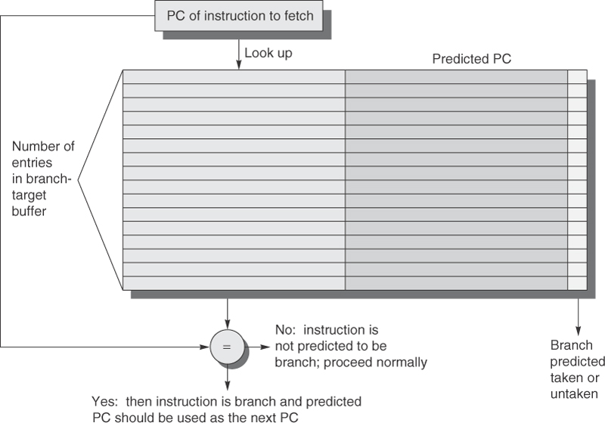
Branch Target Buffer
Our prediction schemes covered earlier only store the prediction, not the branch target location
  some pipelines know where to branch to before they know if they are branching, but if the pipeline determines the branch condition and the branch location at the same time, we may want a different approach
    speculating on both if and where to branch
    superscalars, because of multiple issue, can also take advantage of this
The branch target buffer,
shown to the right, stores
for each PC value, a predicted
PC value

Slide 87
Using the Branch Target Buffer
Fetch branch prediction & target location in IF stage
  fetching occurs simultaneously with instruction cache and branch target buffer (using the instruction’s address)
Still in the IF stage
  is instruction a branch and branch is predicted as taken?
    change PC to be target location returned from buffer
    if cache hit and successful prediction, penalty = 0
  is instruction a branch and predicted to not be taken?
    increment PC as normal
    if cache hit and successful prediction, penalty = 0
  is instruction not a branch?
    increment PC, no penalty
  two sources of penalties
    miss-prediction based on buffer prediction result
    buffer miss – branch instruction but nothing recorded in the target buffer

Slide 88
Performance of Branch Target Buffer
For our 5-stage pipeline, the penalty is a 2 cycle stall
  one cycle to know the result of the branch as computed in the ID stage
  one cycle to modify the cache
    on a buffer miss or a branch miss-prediction
    need this second stall to update the buffer (insert the branch to the cache on a miss, update the prediction on a miss-prediction)
    while this takes place, the next instruction can’t access the cache, thus a 2-cycle penalty
    many high performance processors have lengthy pipelines with branch penalties of 8-15 cycles instead of 2
Assume
  prediction accuracy of 95%, buffer hit rate of 90%
    hit & miss-prediction = .90 * .05 = .045
    miss = .10
  branch penalties then are (.045 + .10) * 2 = .29
  from appendix C, we averaged about between .38 and .56 cycles of penalties from our various schemes

Slide 89
Two Other Speculation Techniques
Branch folding
  store the branch prediction, target location AND the instruction at the target location destination
    if branch and predicted as taken, immediately place predicted instruction into the ID stage
    a successful speculation has a penalty of -1 instead of 0!
      we skip the branch in favor of the predicted instruction itself
    branch address + 4 is used to update the PC for the next instruction
    miss-speculation has a penalty of 2 like before
Return address predictors
  small cache-based stack to store return addresses
  return statements have a destination location, these are predicted just as any other branch
    these are indirect jumps, by using the stack you save on an extra potential memory (or register) references
  miss-prediction rates vary but an 8-element buffer has a miss-prediction rate under 10%

Slide 90
Hardware vs Software Speculation
Software speculation cannot cope with pointer dereferencing
  at compile time, there’s no way to know what is being referenced
  hardware speculation uses a Tomasulo-like approach
Software speculation can still use a pre-compiled branch prediction (or target) buffer but hardware speculation works better when branches are unpredictable
With a ROB, we can maintain precise exceptions
  something that a statically scheduled architecture cannot handle
Compiler scheduling can use a much larger window to collect instructions for multiple issue
Hardware-based speculation requires more hardware so is more expensive and harder to build
In general, hardware-based speculation is preferred

Slide 91
Thread Level Parallelism
ILP has inherent limitations
Can we exploit multithreading?
  thread is defined here as a separate process with its own instructions and data
    unlike the traditional definition of a thread which shares instructions with other threads has its own stack and data
  thread may be a traditional thread or a separate process or a single program executing in parallel
    the idea is that different threads contain different instructions and data so that the processor, when it has to stall, can switch to another thread and continue execution
TLP exploits a different kind of parallelism to ILP

Slide 92
Approaches to TLP
Enhance superscalar with dynamic scheduling along one of two dimensions
Fine-grained multi-threading
  switches between threads at each clock cycle
    threads are executed in an interleaved fashion
    a thread that is currently stalled is skipped over
  CPU must be able to switch between threads every clock cycle so needs extra hardware support
Coarse-grained multi-threading
  switches between threads only when current thread is likely to stall for some time
  switching process can be more time consuming since we are not switching nearly as often and therefore does not need extra hardware support

Slide 93
Advantages/Disadvantages
Fine-grained
  Adv: less susceptible to stalling situations
  Adv: throughput costs can be hidden because stalls are often unnoticed
  Disadv: slows down execution of each thread
  Disadv: requires a switching process that can be done within a cycle to not stall
    requires more hardware (e.g., a PC for each thread and additional hardware logic and latches to deal with multiple threads)
Coarse-grained
  Adv: more natural flow for any given thread
  Adv: easier to implement switching process
  Adv: can be implemented on existing processors
  Disadv: switching between threads is more time consuming and short stalling situations are not overcome so that performance as a whole may suffer compared to fine-grained

Slide 94
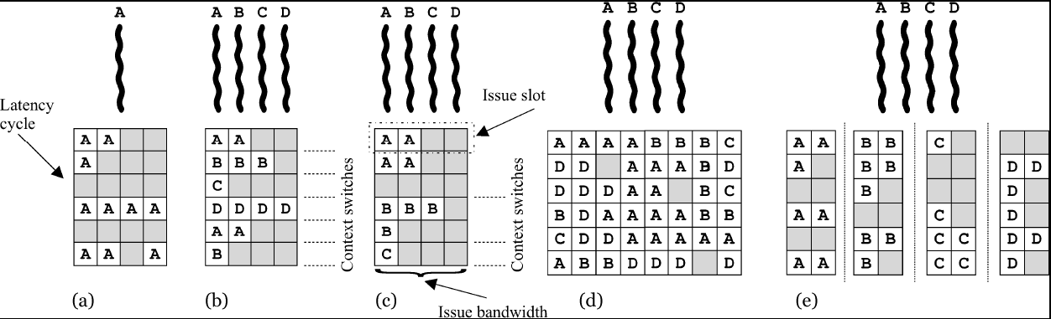
Simultaneous Multi-threading (SMT)
SMT uses multiple issue and dynamic scheduling on our superscalar architecture but adds multi-threading
  (a) has not multi-threading so that there will often be idle slots (cycles) caused by stalls and a lack of ILP
  (b) and (c) are fine-grained and coarse-grained respectively
  (d) shows the potential payoff for SMT
  (e) goes one step further to illustrate multiprocessing

Slide 95
Four Approaches
Superscalar on a single thread (a)
  ILP only, switching threads is equivalent to a context switch, which takes many (dozens or hundreds of) cycles
Superscalar + coarse-grained MT (c)
  easy to implement, performance increase over no (a), contains empty instruction slots due to short stalling situations (as opposed to lengthier stalls associated with cache miss)
Superscalar + fine-grained MT (b)
  switching between threads at each cycle requires more complex and expensive hardware
  eliminates most stalls
  the only problem is that a thread that lacks ILP or cannot make use of all instruction issue slots will not take full advantage of the hardware
Superscalar + SMT (d)
  most efficient way to use hardware and multithreading so that as many functional units as possible can be occupied

Slide 96
Superscalar Limitations for SMT
In spite of the performance increase by combining our superscalar hardware and SMT, there are still inherent limitations
  how many active threads can be considered at one time?
    limited by resources such as number of PCs available to keep track of each thread, size of bus to accommodate multiple threads having instruction fetches at the same time, how many threads can be stored in main memory, etc
  limited size of buffers used to support the superscalar
    reorder buffer, instruction queue, issue buffer
  limitations on bandwidth between CPU and cache/memory
  limitation on the combination of instructions that can be issued at the same time
    consider four threads, each of which contains an abnormally large number of FP * but no FP +, then the multiplier functional unit(s) will be very busy while the adder remains idle

Slide 97
Performance Improvement of SMT
SMT offers only modest improvement over single threading
  in part because issue size has not increased recently
  SMT should use issue size of 4-8 or larger, not practical
  Pentium IV Extreme had improvements of 1.01 and 1.07 for SPEC int and SPEC FP benchmarks respectively over Pentium IV
    Extreme = Pentium IV + SMT support
  running 2 SPEC benchmarks using SMT mode saw improvements from 0.9 to 1.58 (average improvement of 1.20)

Slide 98
Conclusions on SMT
SMT has benefits but costs may outweigh those benefits
With multiple CPU cores (see (e) slide 92) commonly available
  SMT can be simulated with one thread per core
  doesn’t get passed stalling issues but is cheaper
Discussed in the text (but skipped here) is the increasing demands on power consumption
  as we add hardware improvements, power consumption increases
  since a lot of computation is handled by mobile devices using battery power, this becomes a concern
  while we may want to still use dynamic issue superscalars, adding SMT support is a power drain we may not want to add

Slide 99
ARM Cortex-A53
Used in many tablets and cell phones
  requirements favor power utilization over speed
Dual issue
Statically scheduled with some dynamic issue capabilities
8-stage integer pipeline (excluding branches)
  see next slide
  pipeline requires in-order execution so while dependent instructions can be issued together, their execution is serialized
  uses speculation for next instruction address – four different predictors used
FP pipeline extends execution from 2 stages to 5 but only consists of 10 total stages because writeback is not performed by FP (instead, forwarding to reservation stations)

Slide 100
8/10 Stage Pipeline
Notice that 13-entry instruction queue is not a stage, so D2 takes place at the same time as F4

Slide 101
How the Pipeline Works
F1 (fetch 1) – generate PC address, fetch branch target location from a target buffer
  this is a prediction
F2 – fetch instruction based on generated PC
F3/D1 – start decoding instruction, also use a hybrid branch predictor and start using an indirect predictor (takes 2 cycles)
  hybrid branch predictor, indirect predictor used only if branch target buffer is a cache miss
  fetch 2 instructions (paired up by the compiler)
  place instruction in an instruction queue
  if the two instructions cannot be issued simultaneously, insert them into the queue sequentially rather than paired (this prevents what is called a functional hazard)

Slide 102
Continued
D2 – decode instruction
D3/ISS – late decode (if needed) and issue stage
  issue pair of instructions across the appropriate pipeline hardware (2 ALU pipes, 1 MAC pipe, 1 divide pipe, 1 load pipe, 1 store pipe), also read integer register file
EX1 & EX2 – two stage execution for all pipes excluding FP
WR – write result to register file
For FP operations, EX1-WR becomes F1-F5
  First stage is to read FP register
  Remaining stages are FP operation with forwarding to FP hardware and/or register file
  Two FP pipes, one for MUL/DIV/SQRT, one for all other FP operations (+, -, compare, convert to/from int)

Slide 103
Branches
All branches are speculated as follows
  consult single entry branch target cache during F1 stage
    if hit, 0-cycle penalty, immediately use fetched PC for next instruction fetch
  if miss, use 3072-entry hybrid branch predictor during F3, if hit then 2-cycle penalty
  if miss, use 256-entry indirect branch predictor in F4, if hit, then 3-cycle penalty
  also during F4, use 8-deep return stack, 3-cycle penalty
  branches are computed in EX2, if branch speculation is incorrect, then flush pipe and recover from 8-cycle branch penalty
Branches are the biggest source of stalls
  ideal CPI for this processor is .5 but miss-speculation causes between about 2% and 20% “wasted” work

Slide 104
ARM Performance
The other main source of stalls are from
  data hazards
    register reads happen in stage 5, memory operations completed in stage 7 so this will usually amount to no more than 1 cycle of stall
      2 cycles of stalls if the data hazard exists between two instructions issued at the same time
    cache misses play a more significant role in stalls
      see figure 3.37, the top bar is the cache miss stalls compared to the data hazard stalls and miss-speculation penalties
The ARM A53’s ideal CPI = 0.5
  on many benchmarks, its CPI ranges from just under 1 to just over 2 (2.14) with an average of about 1.57
    not including the mcf benchmark

Slide 105
Advanced Multi-Issue Processors
Here is a brief comparison of multi-issue superscalar processors (this information is several years out of date)
Processor | Architecture | Fetch/Issue/Execute | Functional Units | Clock Rate (GHz)
Pentium 4 Extreme | speculative dynamically scheduled, deeply pipelined, SMT | 3/3/4 | 7 int 1 FP | 3.8
AMD Athlon 64 | speculative dynamically scheduled | 3/3/4 | 6 int 3 FP | 2.8
IBM Power 5 | speculative dynamically scheduled, SMT, 2 CPU cores/chip | 8/4/8 | 6 int 2 FP | 1.9
Itanium 2 | EPIC style (see appendix G), primarily statically scheduled | 6/5/11 | 9 int 2 FP | 1.6

Slide 106
Fallacies and Pitfalls
F: Processors with lower CPIs will always be faster
F: Processors with faster clock rates will always be faster
P: Sometimes bigger and dumber is better
  the Pentium 4 had the deepest pipeline (up to 30 stages) to promote ILP with a multi-issue superscalar that used out of order completion – yet spent a lot of time waiting for memory accesses!
P: And sometimes smarter is better than bigger and dumber (more complex branch speculation outperforms other approaches)
P: Believing that there are large amounts of ILP available (if only we had the right techniques to exploit it)
  NOTE: we will cover the Intel Core i7 separately

