Slide 1
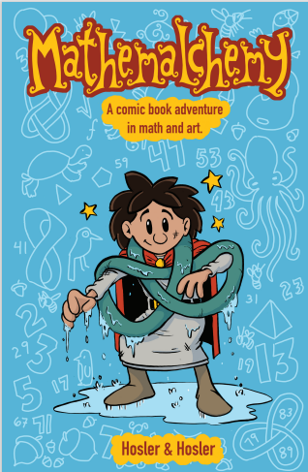
Knotical Mathematical Connections
Our story opens with Emmy having transported herself into the Mathemalchemy universe and plopping into the water. She gets caught in a net the herons and penguins are hoisting aboard their ship. She is caught in a trefoil knot and cannot free herself. She begs them to help “untangle” her from the knot she is stuck in. Their explanation of the various types of knots and how to undo them inspired me to use Children’s yoga poses to introduce the math concepts of knots, over and under connections, and Reidemeister moves to untangle themselves in a fun way to a younger audience.

Slide 2
I found this image online which is how I would present the concepts in play to children.

Slide 3
Some more tie-in imagery to our coursework

Slide 4
Suggestions for play
Introduce Yoga poses to children.
Have images from knots and Mathemalchemy on walls.
Explain the poses with the entwined movements and that there are math concepts about knots that look like Yoga poses they are doing
Explain and imitate the un-tangling moves, tie it into Reidemeister moves
Help the children make songs or poems about the knots.
Have the children create their own twisty poses

Slide 5
Some examples of Yoga Partner Poses

Slide 6
Reidemeister Moves-Explain how to “Un-Tangle” yourselves

Slide 7
Thank you
Mat 115r
Suesana Denton
Mathemalchemy Project

