Slide 1
MAT 115 Donations
Thank you for the wonderful donations!
My campaign totaled our class donations at $755!

Slide 2
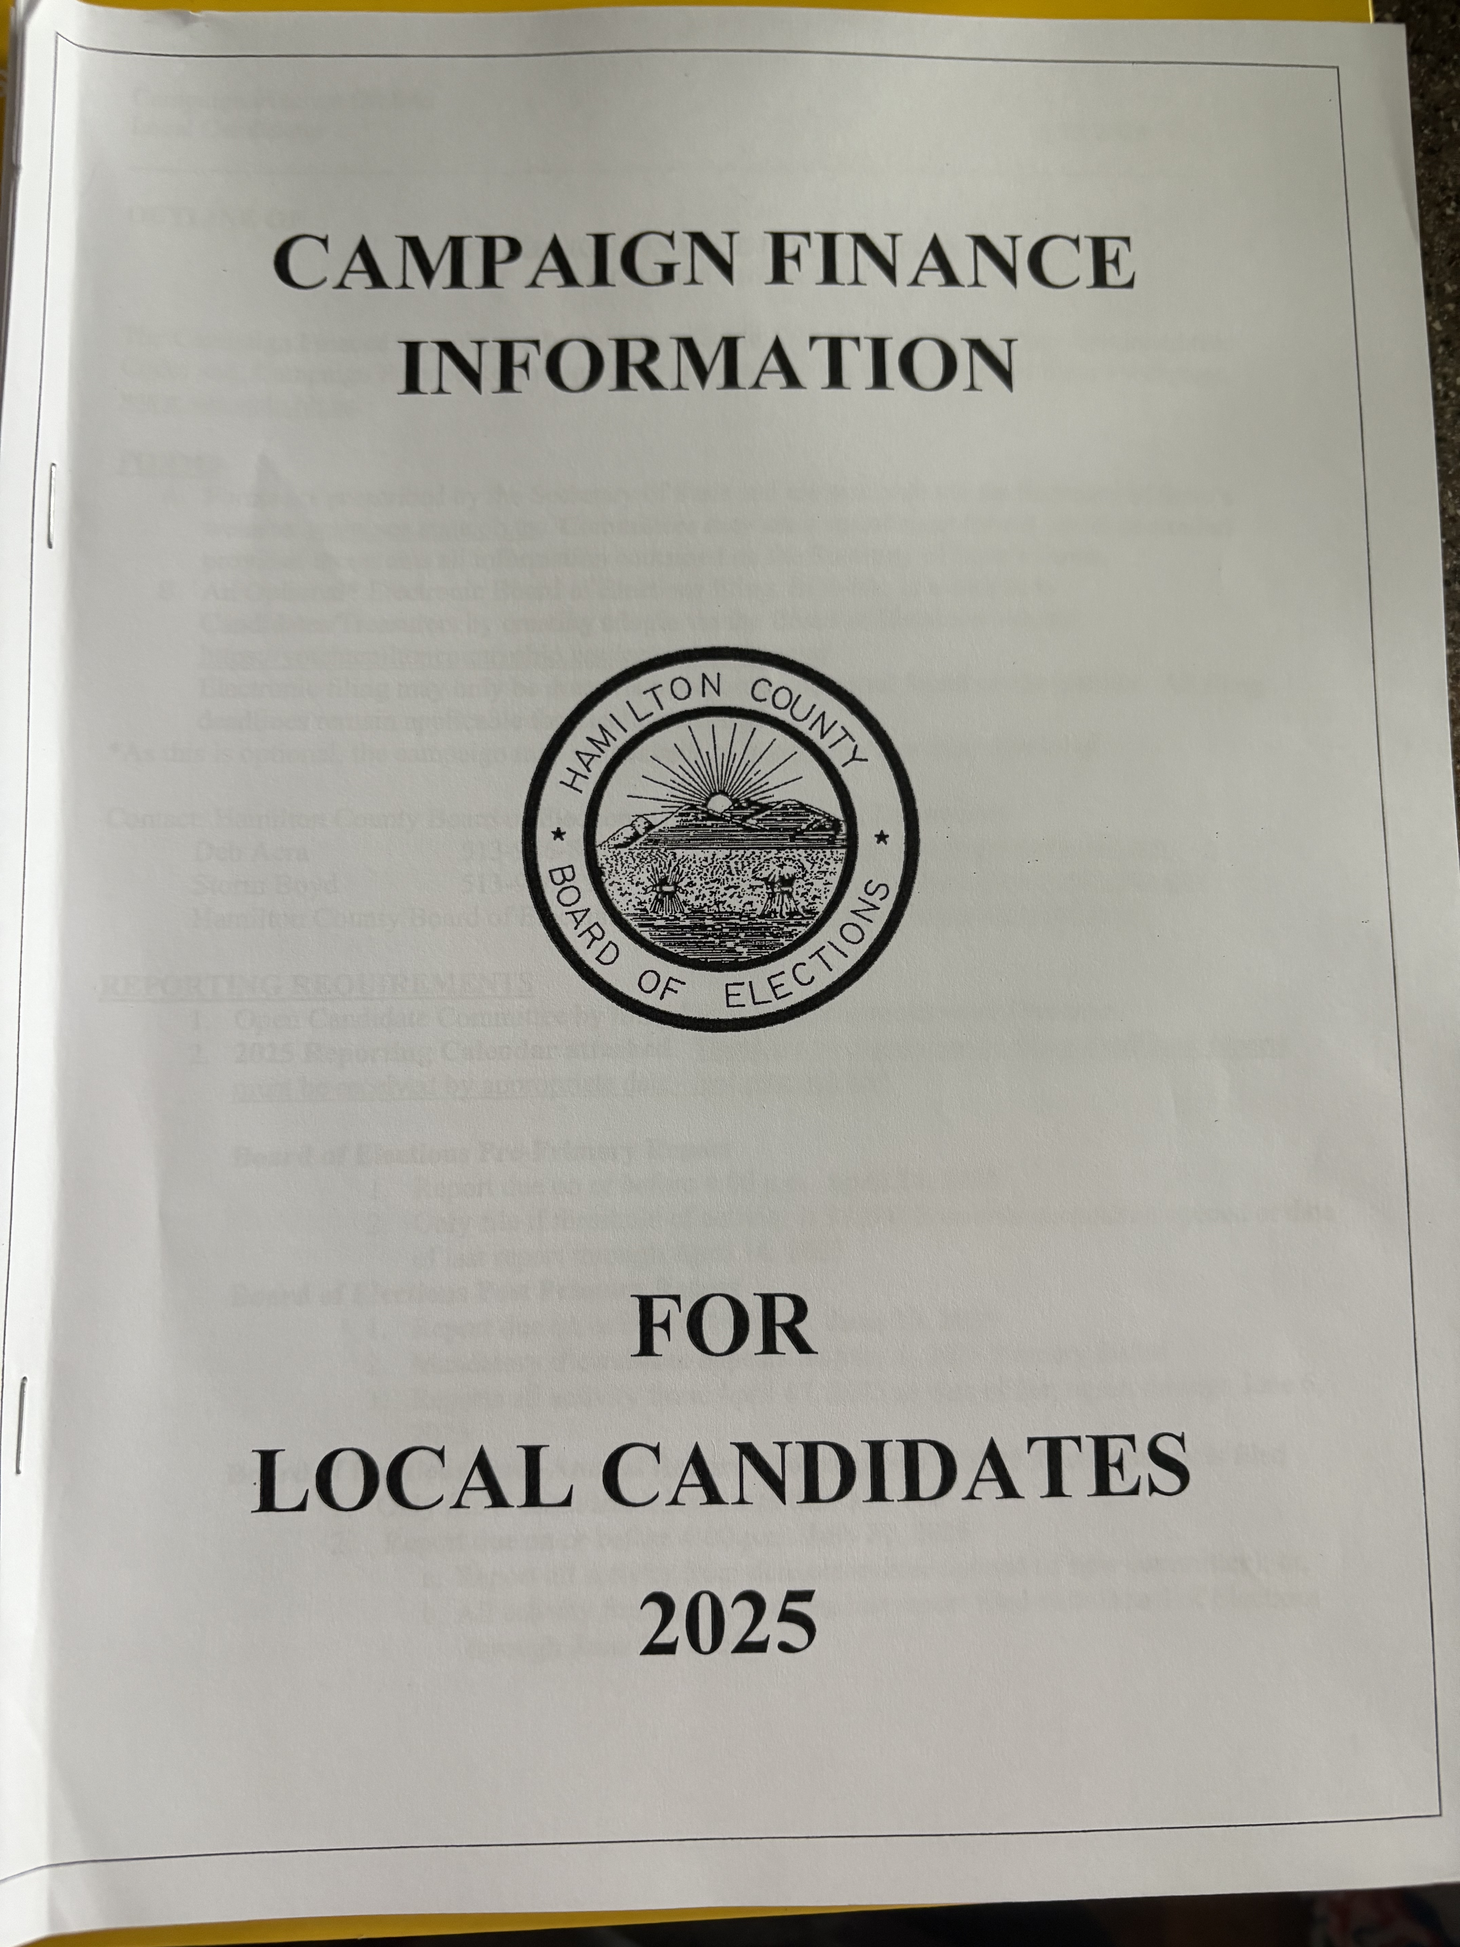
Introducing… The handbook
The campaign handbook is what the Board of Elections gives you after you have filed your petitions for running. This helps track donations so that the public can access this information easily once everything is filed.

Slide 3
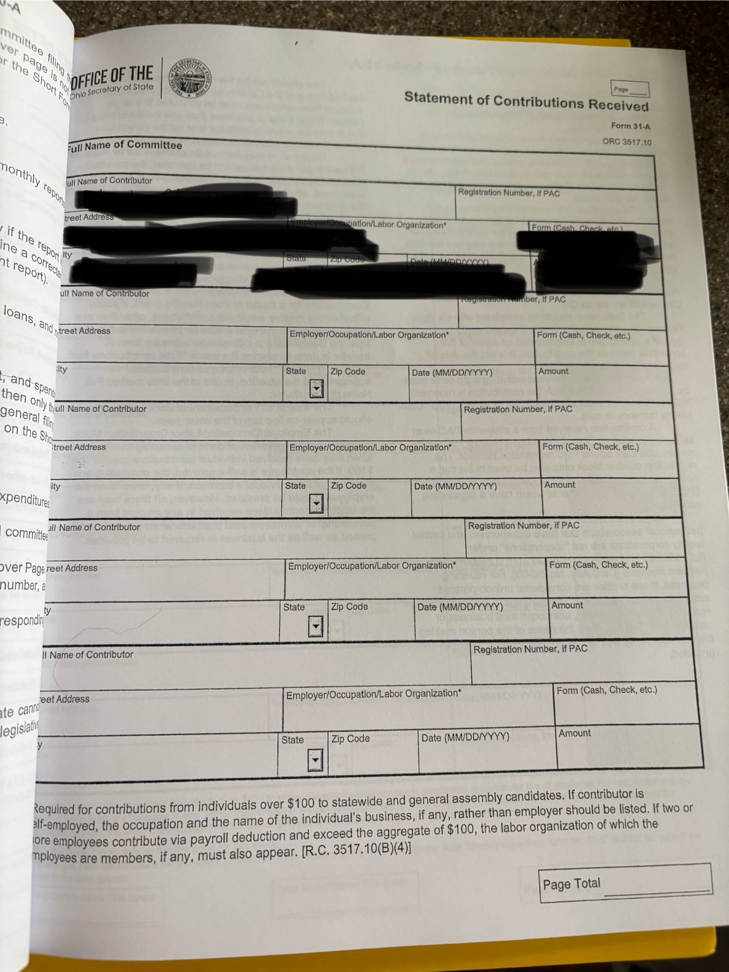

Slide 4
Thank you to professor long, beth, and sean!
These donations mean so much to me!

Slide 5
Proof, for public record…

