Slide 1
Are Online Math Classes Less Effective?: A Research Proposal
By Samm Allphin
(A Psych Major)

Slide 2
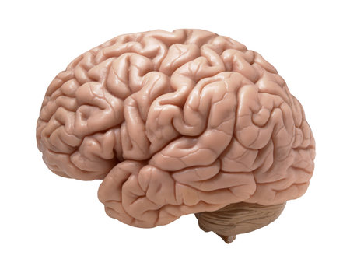
Short Answer, for most.
Most of us were “Personally Victimized” By Covid-19.
Because of this we all have some aversion to online learning even though the internet says it’s wonderful
HOWEVER…

Slide 3
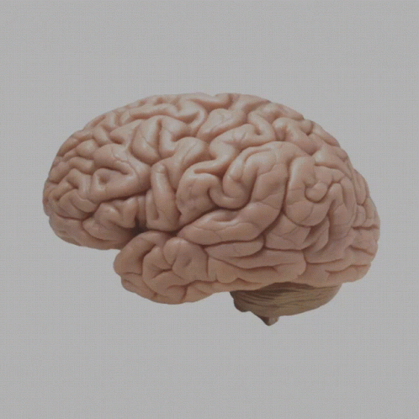
Is it backed by Psychology? The answer is…
Eh, it depends on what factors you are looking for:
Mental health:
According to the NIH (2023) :
Higher anxiety (41%)
Higher levels of Depressive Symptoms (30%)
Chronic Stress (20%)
According to the Journal of Psychiatry Psychology and Behavioral research(2021) :
Social Media Fatigue
Higher levels of Anxiety
Depressive Symptoms

Slide 4
Is It Backed By Psychology…… Continued
Academic performance:
According to Harvard (n.d): Students in an online course experienced a 0.44 grade drop as opposed to their peers in a traditional classroom. In other words, in person students earned a B- vs the online folks who earned a C.
Brain Processing:
According to BrainFacts.org (2020): According to a 2009 study, when reading things on a physical sheet of paper was found to activate the prefrontal and cingulate cortex, known for processing emotions, and generated more activity in the parietal cortex, known for processing visual and spatial cues.
Though, there were very few studies that i found that actually studied the effects of online learning, especially with math, which brings me to my conclusion…

Slide 5
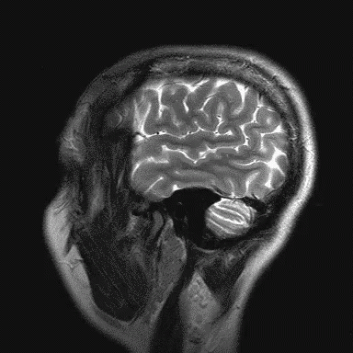
Conclusion!!
We. Need. More. Research.
There isn't a lot of research post-Covid about distance learning and i feel as though its a disservice.
I propose that we research both psychological and academic effects of individuals who have taken online classes in college vs have never taken an online class in college. In this way we could properly investigate if online classes are actually hindering students vs helping them.

Slide 6
SOURCES!!
https://pmc.ncbi.nlm.nih.gov/articles/PMC10007642/#:~:text=This%20research%20assessed%20satisfaction%20with,obtained%20during%20full%2Dtime%20education.
https://scholar.harvard.edu/files/online-inperson-bflt.pdf
https://d1wqtxts1xzle7.cloudfront.net/105494565/25-libre.pdf?1693813592=&response-content-disposition=inline%3B+filename%3DImpact_and_Vulnerability_of_Distance_Lea.pdf&Expires=1745416848&Signature=bFXusojSLJpsA3IKvCtY6Kp0lbpq7mrGPHnRpSdGZ~D5CeEZCJyswSxo5u~JMJMs-EdiA6~J-z3kODt-s9spTE8dciBNk~mfTtFRim4ie~RNy0oearcW4BXBqmesKfI8ZY~7OOn5IoF-FojgbCFYWcuzIsnE8X2qkai-SxpJarPb0ZhSaqVcq86pPCyER8pGftIWXydey-uOnq2R8MJE~5XmR3oWVY5lx~xc16Vzxd5aAeslZrkLQeZhNZvzwssyi9v9TOGU5gF8bnhVMRK~36oBv7NsslwaclFCvYyGdbteQt75JLrext0rDcQ7n3MSh~k2LW7dGVWjVXm-mN1~IA__&Key-Pair-Id=APKAJLOHF5GGSLRBV4ZA
https://www.brainfacts.org/neuroscience-in-society/tech-and-the-brain/2020/reading-on-paper-versus-screens-whats-the-difference-072820#:~:text=TL;DR:%20Digital%20Reading%20Equals,processes%20visual%20and%20spatial%20cues.

